Slide 1

Introductions

Slide 2



A fishy story
What is the mathematical water our pupils are swimming through?

Slide 3
A fishy story
What is the mathematical water our pupils are swimming through?
The Depth
The Beauty
The Logicalness
The History
The Applications
The Connections

Slide 4
The Logicalness
Maths should be less magical.

Slide 5
A fishy story
What is the mathematical water our pupils are swimming through?
The Depth
The Beauty
The Logicalness
The History
The Applications
The Connections

Slide 6
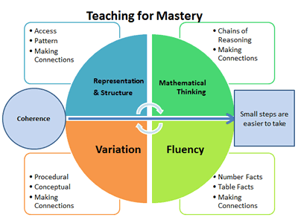
The Connections
Maths should feel like Game of Thrones.
Not Friends.

Slide 7

Introducing Interweaving
What?

Slide 8
Introducing Interweaving
What?
Interweaving:
Using questions and tasks that bring together multiple different topics from across mathematics.

Slide 9
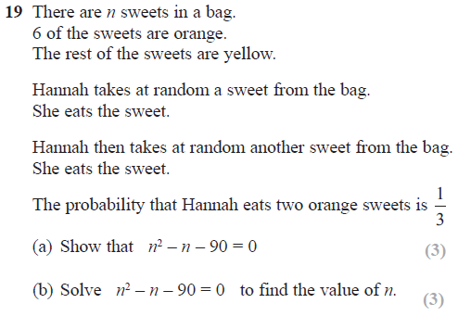
Introducing Interweaving
Why?
1 – Connections
2 – Retrieval
3 – Depth
4 – Challenge
5 – Purpose
(6 – The Hannah Questions)

Slide 10
Introducing Interweaving
Who? When?
Year 7 Transition
Year 11 Revision
Year 12 Consolidation

Slide 11
Introducing Interweaving
How?
Inputs | Processes | Contexts
Fractions | Equations | Geometry
Surds | Ratios | Averages
Standard Form | Sequences | Rounding

Slide 12
Introducing Interweaving
How?
Inputs | Processes | Contexts
Fractions | Equations | Geometry
Surds | Ratios | Averages
Standard Form | Sequences | Rounding

Slide 13
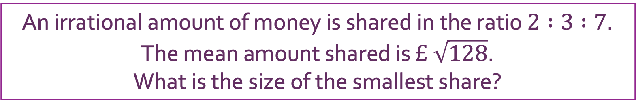
Introducing Interweaving
How?
Inputs | Processes | Contexts
Fractions | Equations | Geometry
Surds | Ratios | Averages
Standard Form | Sequences | Rounding
An irrational amount of money is shared in the ratio $2 :3 :7$.
The mean amount shared is $£ \sqrt{128}$.
What is the size of the smallest share?

Slide 14
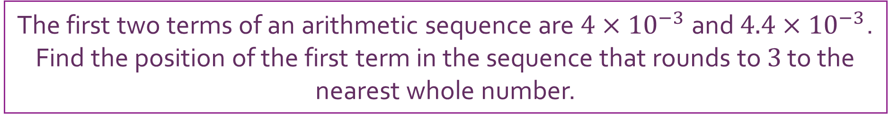
Introducing Interweaving
How?
Inputs | Processes | Contexts
Fractions | Equations | Geometry
Surds | Ratios | Averages
Standard Form | Sequences | Rounding
The first two terms of an arithmetic sequence are $4×{10}^{−3}$ and $4.4×{10}^{−3}$.
Find the position of the first term in the sequence that rounds to $3$ to the nearest whole number.

Slide 15
Introducing Interweaving
Considerations
Overcoming novelty
Avoiding chaining
Giving structure

Slide 16



Creating Interwoven Questions
Interweave this question.
$$?$$
$$3$$
$4$

Slide 17


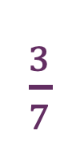

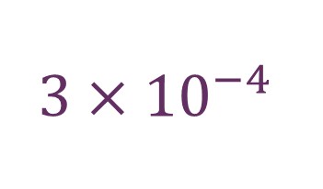

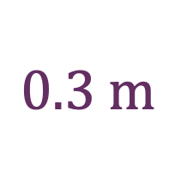




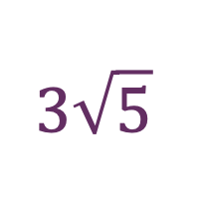
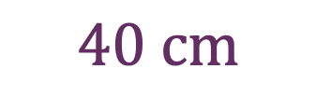

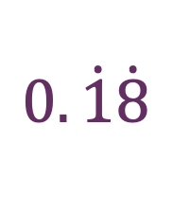



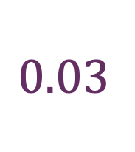


Creating Interwoven Questions
$$?$$
$$?$$
$\frac{3}{7}$
$$?$$
$$3\sqrt{5}$$
$$3$$
$\frac{4}{7}$
$4\sqrt{5}$
$$?$$
$4$
$$0.\dot{1}\dot{8}$$
$$?$$
$$3×{10}^{−4}$$
$$?$$
$$0.\dot{2}\dot{4}$$
$$?$$
$$0.3 \text{m}$$
$$0.03$$
$4×{10}^{−4}$
$40 \text{cm}$
$0.04$

Slide 18



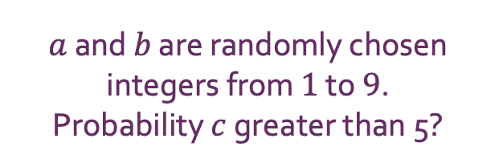




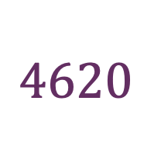

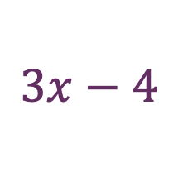







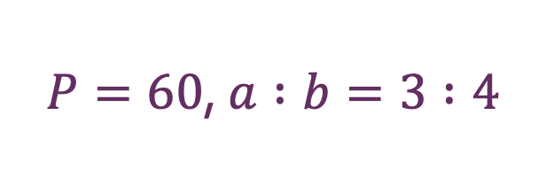
Creating Interwoven Questions
$$5x−2$$
Prime Factorisation!
$$?$$
$$?$$
$$3x−4$$
$$3$$
$$4620$$
$$4x$$
$6160$
$4$
$P=60$, $a :b=3 :4$
$a$ and $b$ are randomly chosen integers from $1$ to $9$.
Probability $c$ greater than 5?
$$?$$
$$3$$
$$?$$
$$c$$
$$a$$
$$a$$
$4$
$$b$$
$$b$$

Slide 19
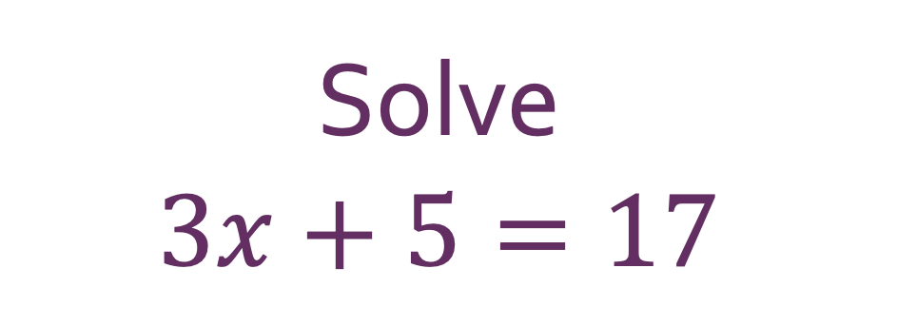
Creating Interwoven Questions
Interweave this question.
Solve
$$3x+5=17$$

Slide 20
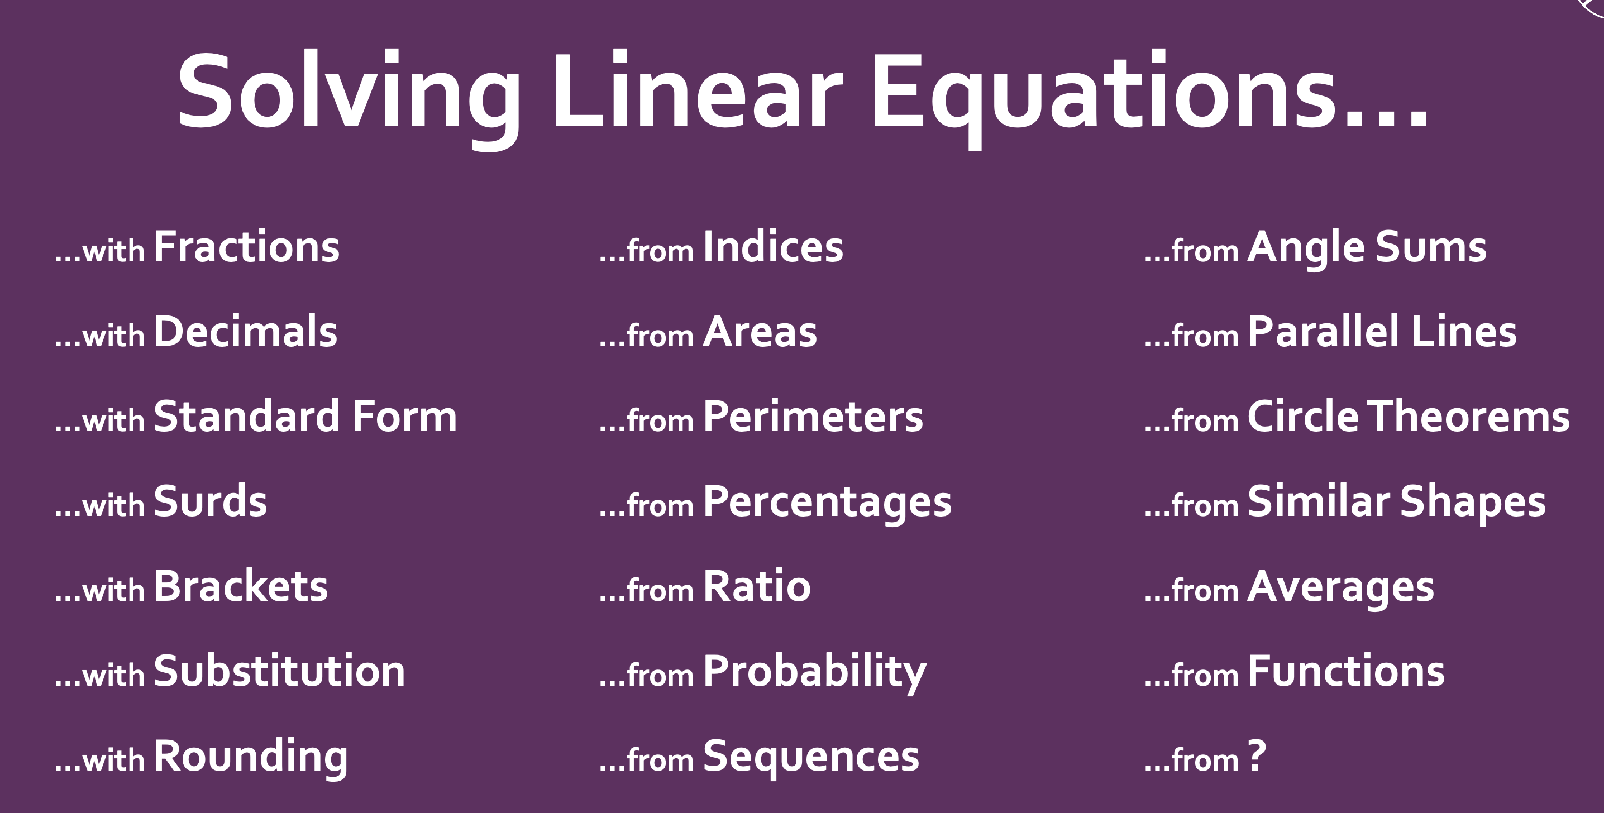
Creating Interwoven Tasks

Slide 21
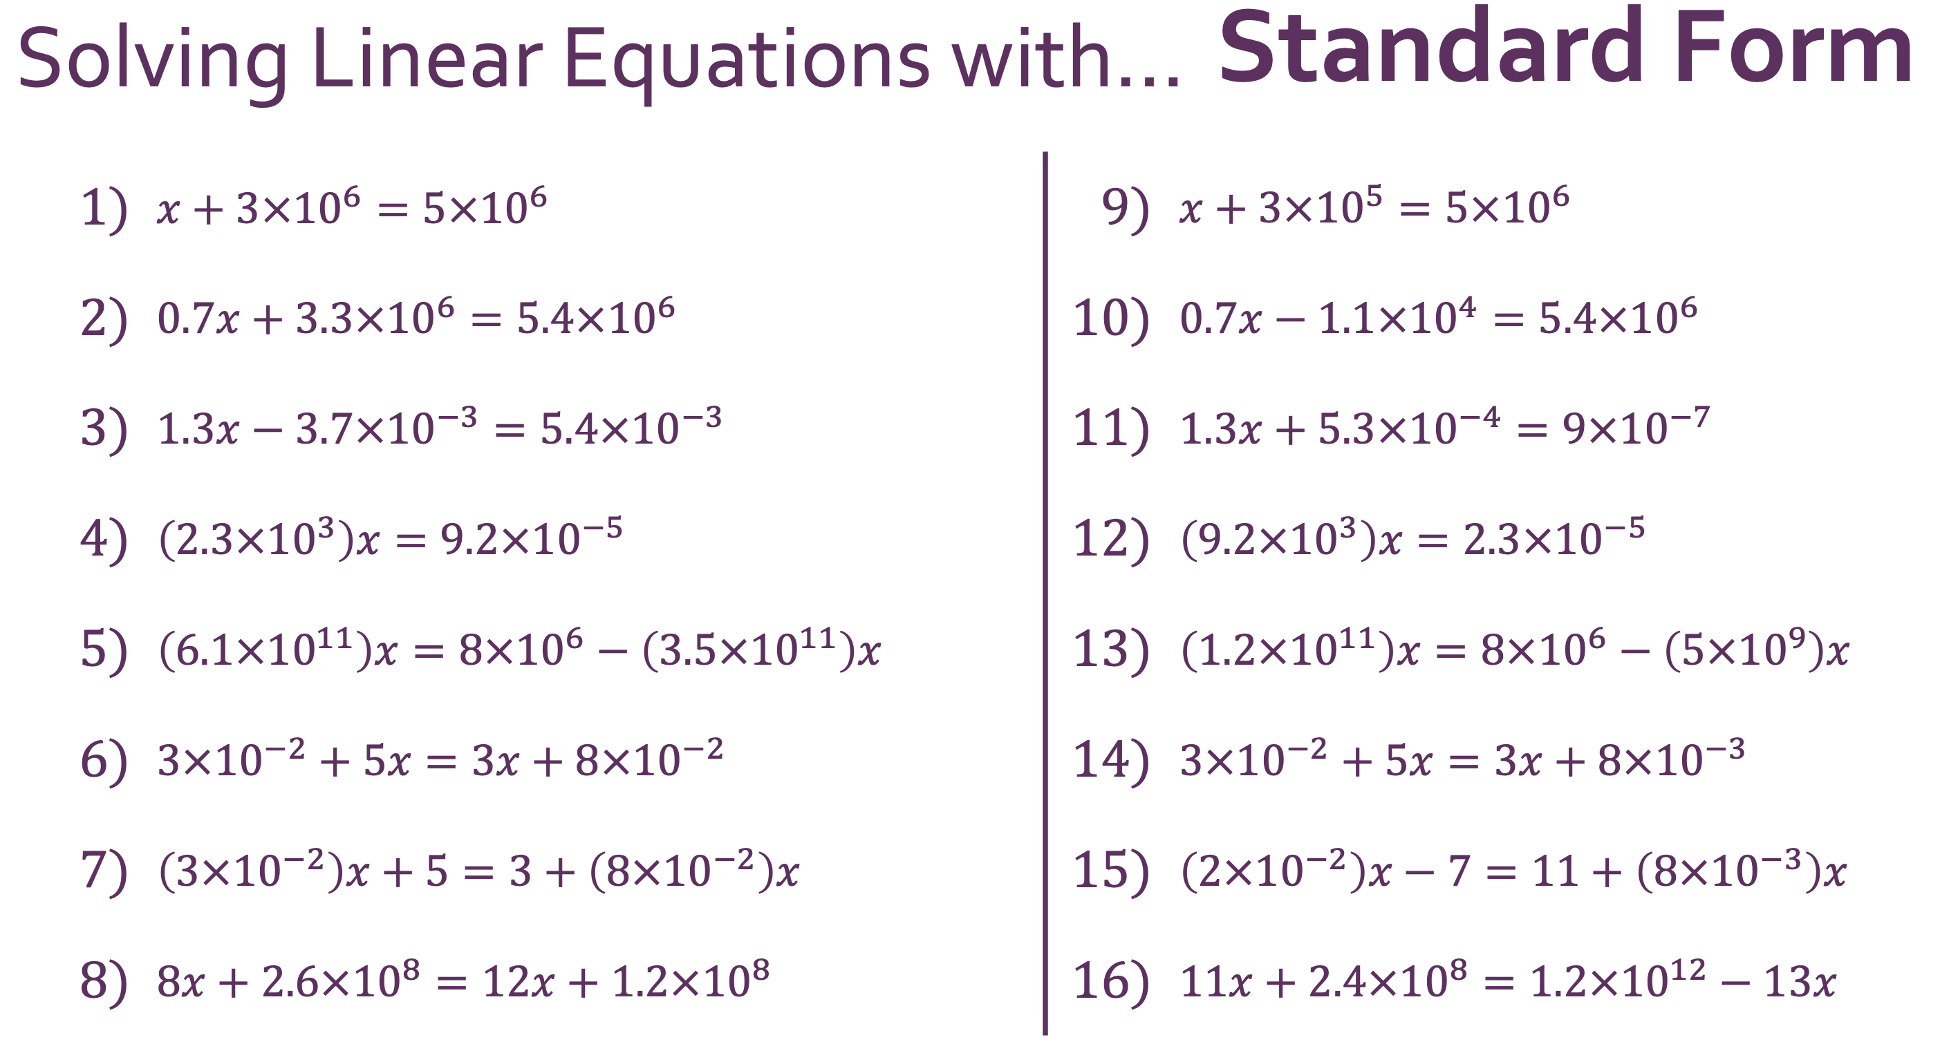
Creating Interwoven Tasks

Slide 22
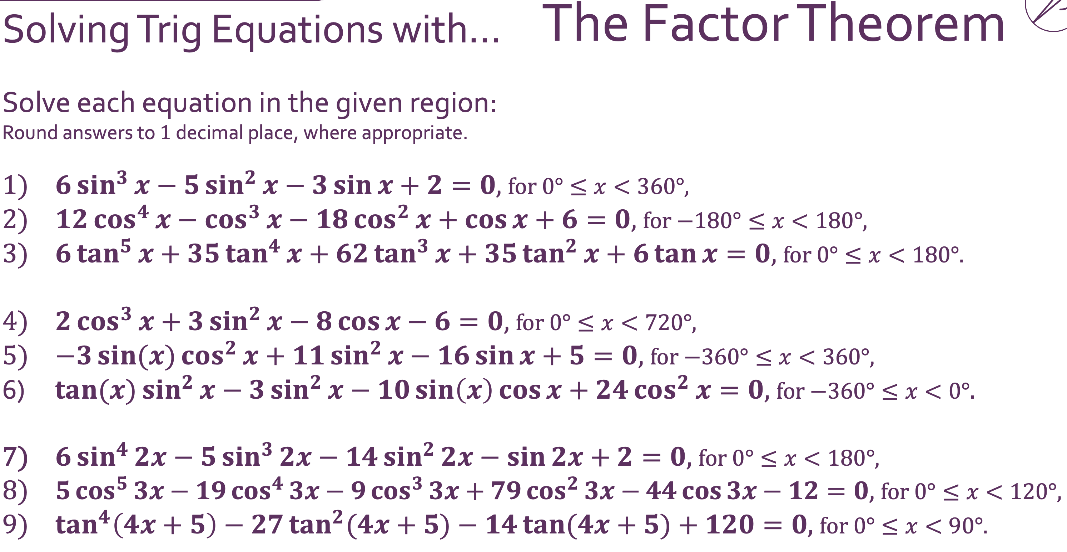
Creating Interwoven Tasks

Slide 23

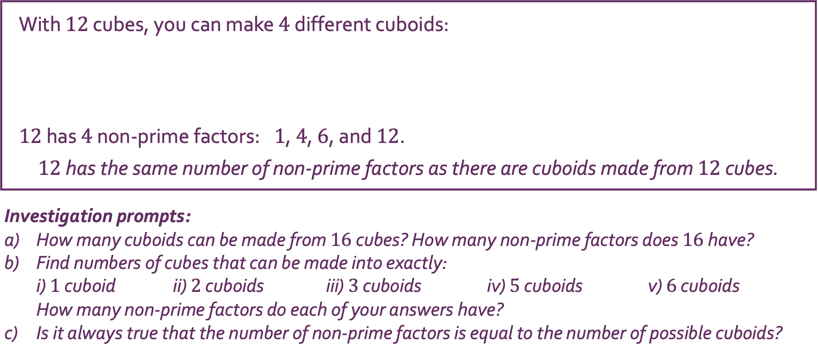



Creating Interwoven Tasks
With $12$ cubes, you can make $4$ different cuboids: $12$ has $4$ non-prime factors: $1$, $4$, $6$, and $12$. $12$ has the same number of non-prime factors as there are cuboids made from $12$ cubes.
Investigation prompts: How many cuboids can be made from $16$ cubes? How many non-prime factors does $16$ have? Find numbers of cubes that can be made into exactly: i) $1$ cuboid ii) $2$ cuboids iii) $3$ cuboids iv) $5$ cuboids v) $6$ cuboids How many non-prime factors do each of your answers have? Is it always true that the number of non-prime factors is equal to the number of possible cuboids?
$$1×1×12$$
$$1×2×6$$
$$1×3×4$$
$$2×2×3$$

Slide 24
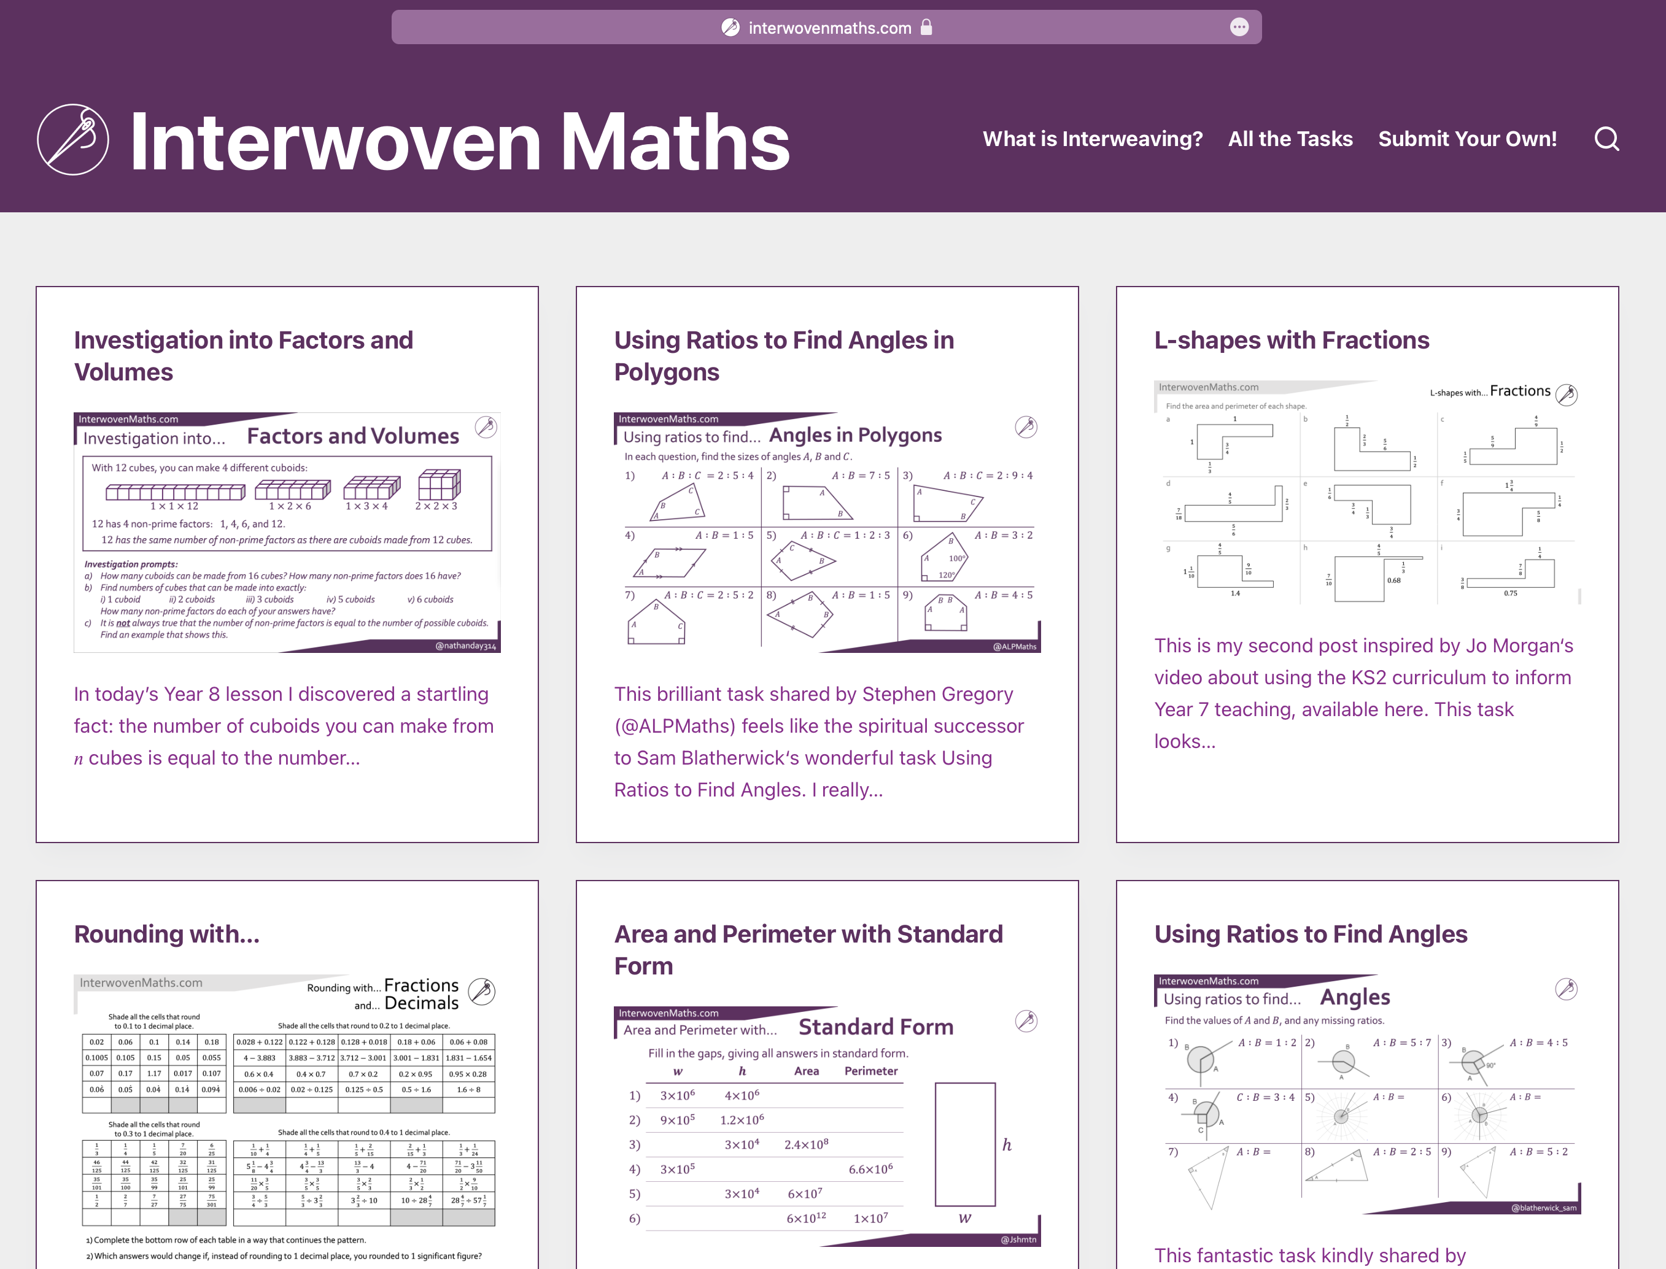
Using Interwoven Tasks
interwovenmaths.com
Try the questions first
Model carefully
Be selective
Adapt and improve!

Slide 25
Creating Interwoven Tasks

