Slide 1
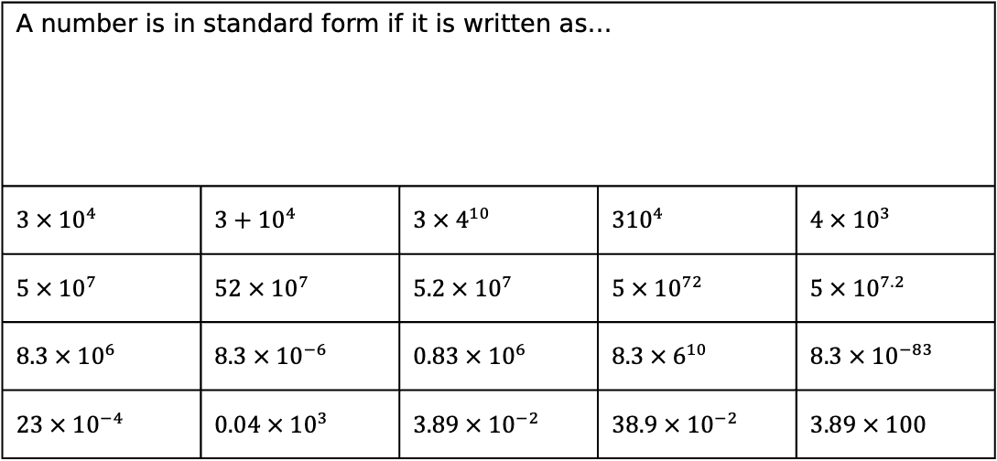
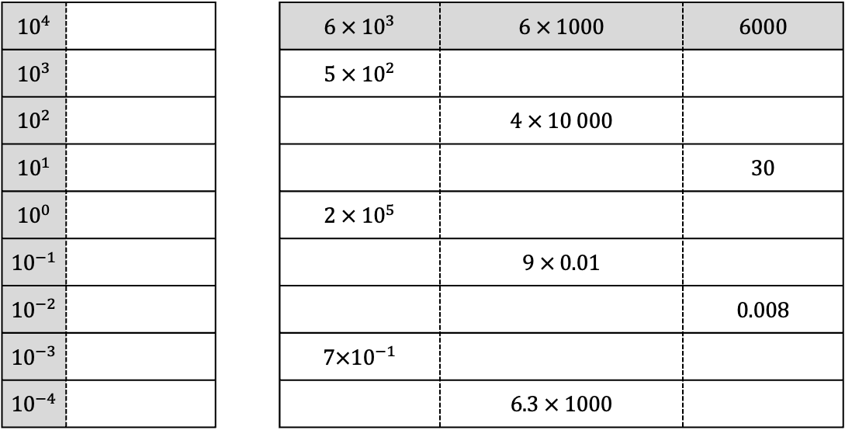
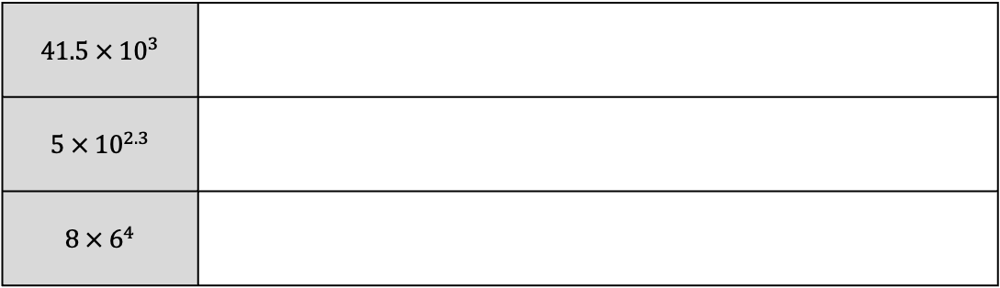
Task 1: Fill in the blanks.
${10}^{4}$ |  |  | $6 × {10}^{3}$ | $6 × 1000$ | $6000$
${10}^{3}$ |  |  | $5 × {10}^{2}$
${10}^{2}$ |  |  |  | $4 × 10 000$
${10}^{1}$ |  |  |  |  | $30$
${10}^{0}$ |  |  | $2 × {10}^{5}$
${10}^{−1}$ |  |  |  | $9 × 0.01$
${10}^{−2}$ |  |  |  |  | $0.008$
${10}^{−3}$ |  |  | $7×{10}^{−1}$
${10}^{−4}$ |  |  |  | $6.3 × 1000$
Task 2: Which of the following numbers are written in standard form.
A number is in standard form if it is written as…
$3 × {10}^{4}$ | $3+{10}^{4}$ | $3 × 4^{10}$ | ${310}^{4}$ | $4 × {10}^{3}$
$5 × {10}^{7}$ | $52 × {10}^{7}$ | $5.2 × {10}^{7}$ | $5 × {10}^{72}$ | $5 × {10}^{7.2}$
$8.3 × {10}^{6}$ | $8.3 × {10}^{−6}$ | $0.83 × {10}^{6}$ | $8.3 × 6^{10}$ | $8.3 × {10}^{−83}$
$23 × {10}^{−4}$ | $0.04 × {10}^{3}$ | $3.89 × {10}^{−2}$ | $38.9 × {10}^{−2}$ | $3.89 × 100$
Task 3: Explain why each of the following are not in standard form.
$$41.5 × {10}^{3}$$
$$5 × {10}^{2.3}$$
$$8 × 6^{4}$$

Slide 2
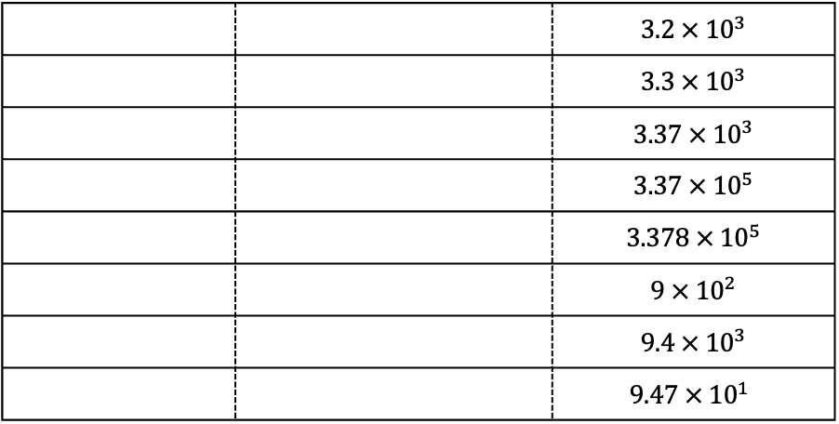
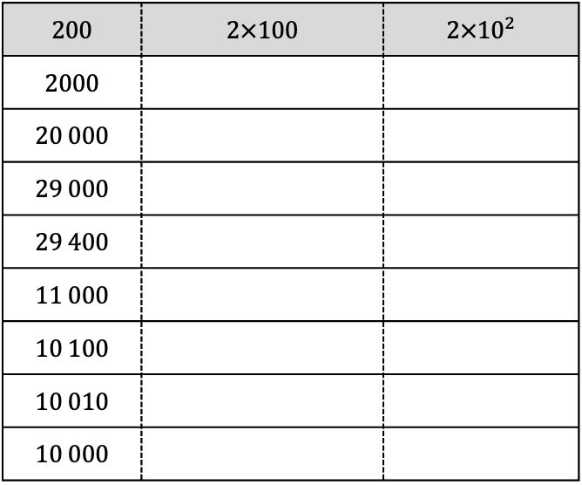
Task 4: Fill in the blanks.
$200$ | $2×100$ | $2×{10}^{2}$
2000
20 000
29 000
29 400
11 000
10 100
10 010
10 000
29 470
294 700
994 700
1 994 700
1947
194.7
19.47
1.947
0.1947
Task 5: Fill in the blanks.
 |  | $3.2 × {10}^{3}$
 |  | $3.3 × {10}^{3}$
 |  | $3.37 × {10}^{3}$
 |  | $3.37 × {10}^{5}$
 |  | $3.378 × {10}^{5}$
 |  | $9 × {10}^{2}$
 |  | $9.4 × {10}^{3}$
 |  | $$9.47 × {10}^{1}$$
Task 6:
Omitted White Rose questions on comparing numbers in Standard Form

Slide 3
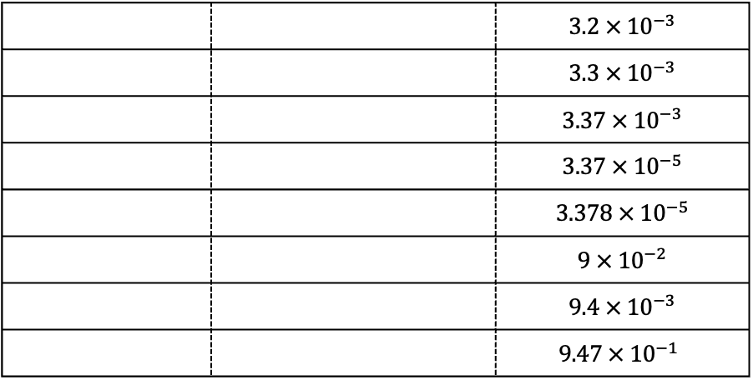
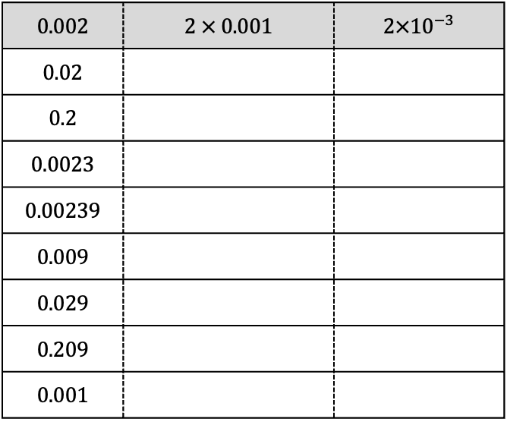
Task 7: Fill in the blanks.
$0.002$ | $2 × 0.001$ | $2×{10}^{−3}$
0.02
0.2
0.0023
0.00239
0.009
0.029
0.209
0.001
0.0081
0.00081
0.000081
0.000801
0.008001
0.08001
0.8001
8.001
800.1
Task 8: Fill in the blanks.
 |  | $3.2 × {10}^{−3}$
 |  | $3.3 × {10}^{−3}$
 |  | $3.37 × {10}^{−3}$
 |  | $3.37 × {10}^{−5}$
 |  | $3.378 × {10}^{−5}$
 |  | $9 × {10}^{−2}$
 |  | $9.4 × {10}^{−3}$
 |  | $$9.47 × {10}^{−1}$$
Task 9:
Omitted White Rose questions on comparing numbers in Standard Form

Slide 4
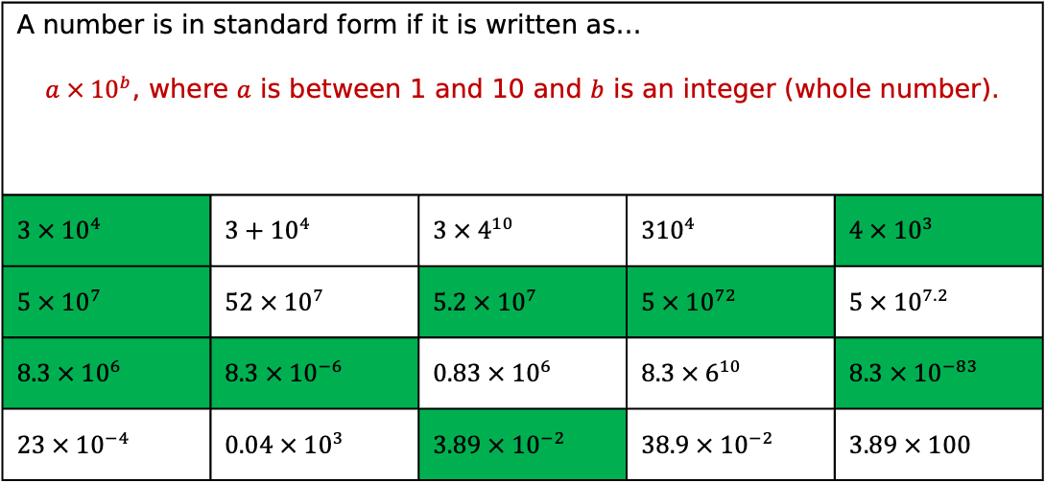
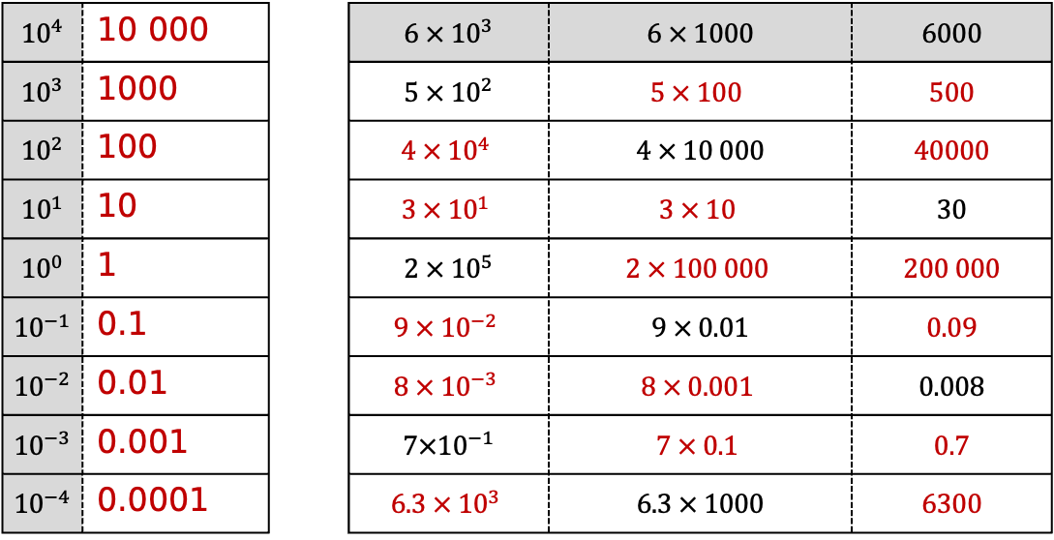
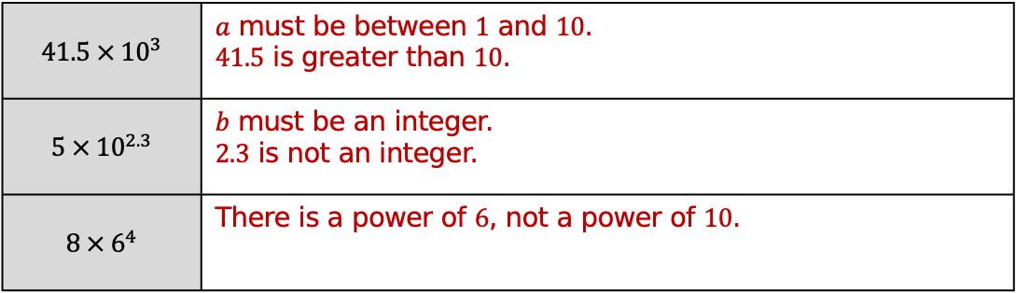
Task 1: Fill in the blanks.
${10}^{4}$ | 10 000 |  | $6 × {10}^{3}$ | $6 × 1000$ | $6000$
${10}^{3}$ | 1000 |  | $5 × {10}^{2}$ | $$5 × 100$$ | $500$
${10}^{2}$ | 100 |  | $$4 × {10}^{4}$$ | $4 × 10 000$ | $40000$
${10}^{1}$ | 10 |  | $$3 × {10}^{1}$$ | $$3 × 10$$ | $30$
${10}^{0}$ | 1 |  | $2 × {10}^{5}$ | $$2 × 100 000$$ | $200 000$
${10}^{−1}$ | 0.1 |  | $$9 × {10}^{−2}$$ | $9 × 0.01$ | $0.09$
${10}^{−2}$ | 0.01 |  | $$8 × {10}^{−3}$$ | $$8 × 0.001$$ | $0.008$
${10}^{−3}$ | 0.001 |  | $7×{10}^{−1}$ | $$7 × 0.1$$ | $0.7$
${10}^{−4}$ | 0.0001 |  | $$6.3 × {10}^{3}$$ | $6.3 × 1000$ | $6300$
Task 2: Which of the following numbers are written in standard form.
A number is in standard form if it is written as… $a × {10}^{b}$, where $a$ is between 1 and 10 and $b$ is an integer (whole number).
$3 × {10}^{4}$ | $3+{10}^{4}$ | $3 × 4^{10}$ | ${310}^{4}$ | $4 × {10}^{3}$
$5 × {10}^{7}$ | $52 × {10}^{7}$ | $5.2 × {10}^{7}$ | $5 × {10}^{72}$ | $5 × {10}^{7.2}$
$8.3 × {10}^{6}$ | $8.3 × {10}^{−6}$ | $0.83 × {10}^{6}$ | $8.3 × 6^{10}$ | $8.3 × {10}^{−83}$
$23 × {10}^{−4}$ | $0.04 × {10}^{3}$ | $3.89 × {10}^{−2}$ | $38.9 × {10}^{−2}$ | $3.89 × 100$
Task 3: Explain why each of the following are not in standard form.
$$41.5 × {10}^{3}$$ | $a$ must be between $1$ and $10$. $41.5$ is greater than $10$.
$$5 × {10}^{2.3}$$ | $b$ must be an integer. $2.3$ is not an integer.
$$8 × 6^{4}$$ | There is a power of $6$, not a power of $10$.

Slide 5
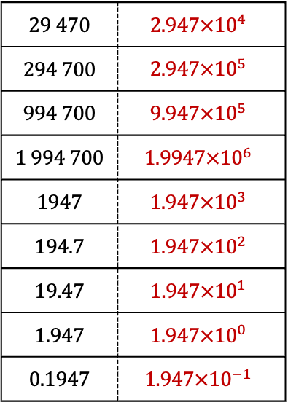
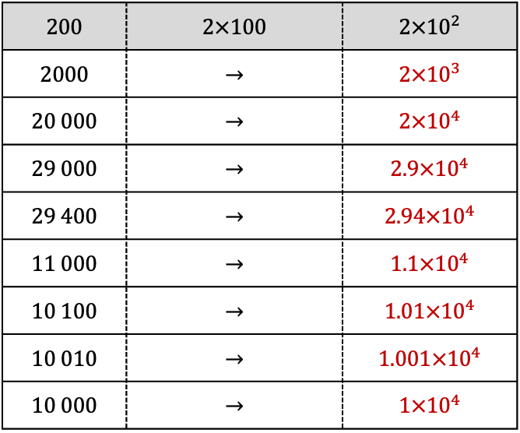
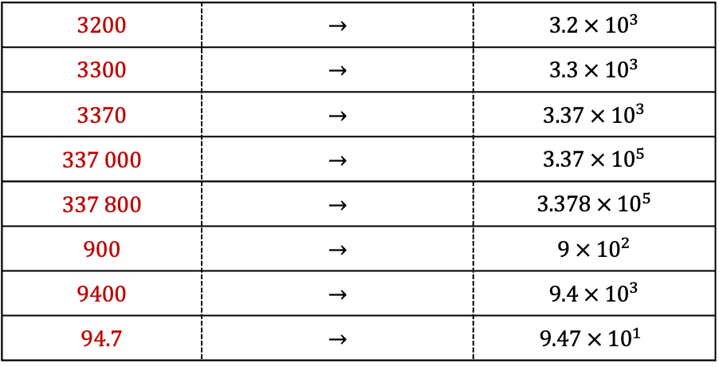
Task 4: Fill in the blanks.
$200$ | $2×100$ | $2×{10}^{2}$
2000 | $→$ | $2×{10}^{3}$
20 000 | $→$ | $2×{10}^{4}$
29 000 | $→$ | $2.9×{10}^{4}$
29 400 | $→$ | $2.94×{10}^{4}$
11 000 | $→$ | $1.1×{10}^{4}$
10 100 | $→$ | $1.01×{10}^{4}$
10 010 | $→$ | $1.001×{10}^{4}$
10 000 | $→$ | $1×{10}^{4}$
29 470 | $$2.947×{10}^{4}$$
294 700 | $$2.947×{10}^{5}$$
994 700 | $$9.947×{10}^{5}$$
1 994 700 | $$1.9947×{10}^{6}$$
1947 | $$1.947×{10}^{3}$$
194.7 | $$1.947×{10}^{2}$$
19.47 | $$1.947×{10}^{1}$$
1.947 | $$1.947×{10}^{0}$$
0.1947 | $$1.947×{10}^{−1}$$
Task 5: Fill in the blanks.
3200 | $→$ | $3.2 × {10}^{3}$
3300 | $→$ | $3.3 × {10}^{3}$
3370 | $→$ | $3.37 × {10}^{3}$
337 000 | $→$ | $3.37 × {10}^{5}$
337 800 | $→$ | $3.378 × {10}^{5}$
900 | $→$ | $9 × {10}^{2}$
9400 | $→$ | $9.4 × {10}^{3}$
94.7 | $→$ | $$9.47 × {10}^{1}$$
Task 6:
Omitted White Rose questions on comparing numbers in Standard Form

