Slide 1
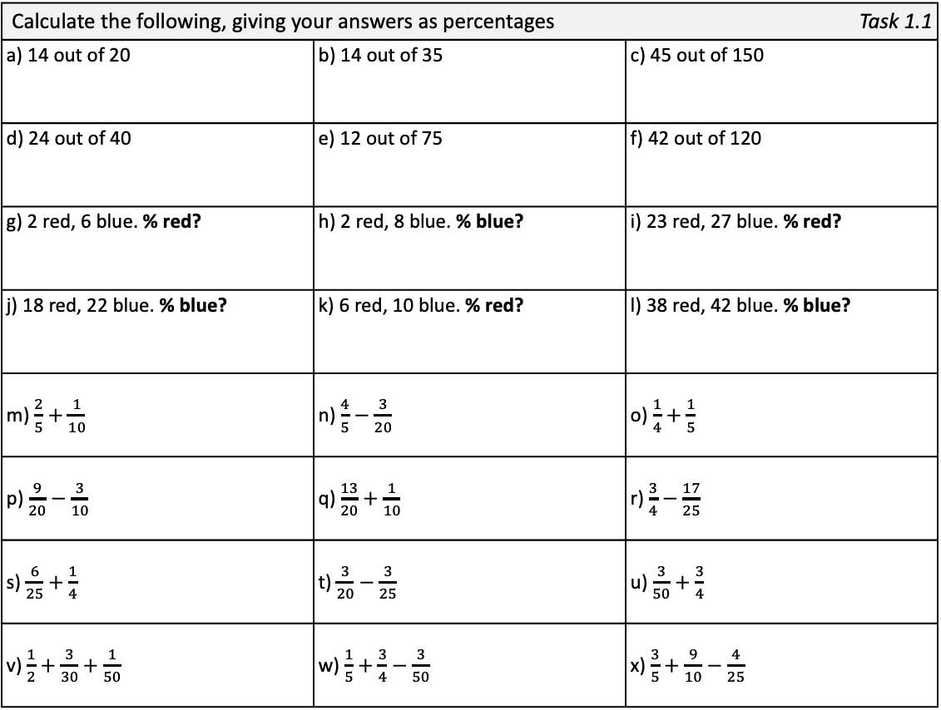
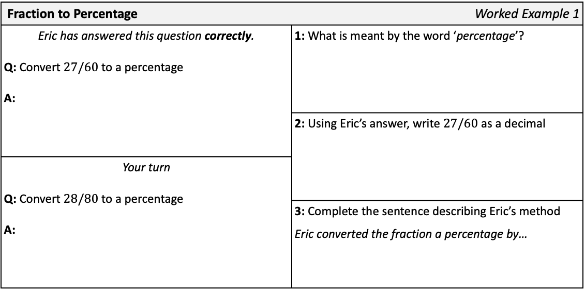
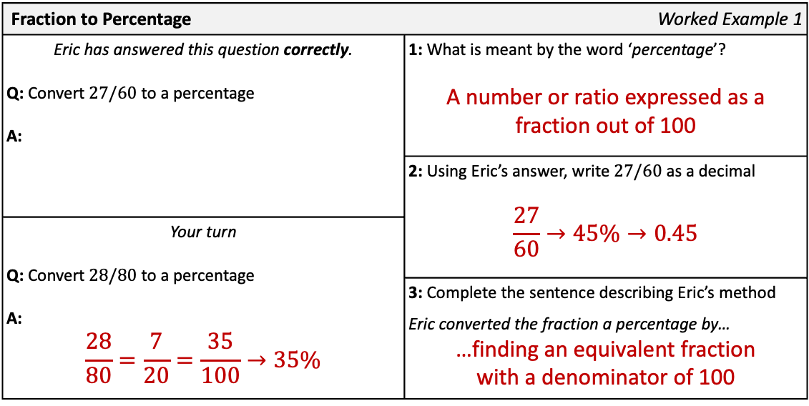

Fraction to Percentage | Worked Example 1
Eric has answered this question correctly. Q: Convert $27/60$ to a percentage A: | 1: What is meant by the word ‘percentage’?
 | 2: Using Eric’s answer, write 27/60 as a decimal
Your turn Q: Convert $28/80$ to a percentage A:
 | 3: Complete the sentence describing Eric’s method Eric converted the fraction a percentage by…
Fraction to Percentage | Worked Example 1
Eric has answered this question correctly. Q: Convert $27/60$ to a percentage A: | 1: What is meant by the word ‘percentage’? A number or ratio expressed as a fraction out of 100
 | 2: Using Eric’s answer, write 27/60 as a decimal $$\frac{27}{60}→45\%→0.45$$
Your turn Q: Convert $28/80$ to a percentage A: $$\frac{28}{80}=\frac{7}{20}=\frac{35}{100}→35\%$$
 | 3: Complete the sentence describing Eric’s method Eric converted the fraction a percentage by… …finding an equivalent fraction with a denominator of 100
Calculate the following, giving your answers as percentages |  | Task 1.1
a) 14 out of 20 | b) 14 out of 35 | c) 45 out of 150
d) 24 out of 40 | e) 12 out of 75 | f) 42 out of 120
g) 2 red, 6 blue. % red? | h) 2 red, 8 blue. % blue? | i) 23 red, 27 blue. % red?
j) 18 red, 22 blue. % blue? | k) 6 red, 10 blue. % red? | l) 38 red, 42 blue. % blue?
m) $\frac{2}{5}+\frac{1}{10}$ | n) $\frac{4}{5}−\frac{3}{20}$ | o) $\frac{1}{4}+\frac{1}{5}$
p) $\frac{9}{20}−\frac{3}{10}$ | q) $\frac{13}{20}+\frac{1}{10}$ | r) $\frac{3}{4}−\frac{17}{25}$
s) $\frac{6}{25}+\frac{1}{4}$ | t) $\frac{3}{20}−\frac{3}{25}$ | u) $\frac{3}{50}+\frac{3}{4}$
v) $\frac{1}{2}+\frac{3}{30}+\frac{1}{50}$ | w) $\frac{1}{5}+\frac{3}{4}−\frac{3}{50}$ | x) $\frac{3}{5}+\frac{9}{10}−\frac{4}{25}$
 | 3% |  | 7% |  | 15% |  | 16% |  | 25% |  | 30% |  | 35% |  | 37.5%
 | 40% |  | 45% |  | 46% |  | 49% |  | 50% |  | 52.5% |  | 55% |  | 60%
 | 62% |  | 65% | a | 70% |  | 75% |  | 80% |  | 81% |  | 89% |  | 134%
t | 3% | r | 7% | p | 15% | e | 16% | g | 25% | c | 30% | f | 35% | k | 37.5%
b | 40% | o | 45% | i | 46% | s | 49% | m | 50% | l | 52.5% | j | 55% | d | 60%
v | 62% | n | 65% | a | 70% | q | 75% | h | 80% | u | 81% | w | 89% | x | 134%

Slide 2
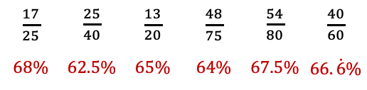
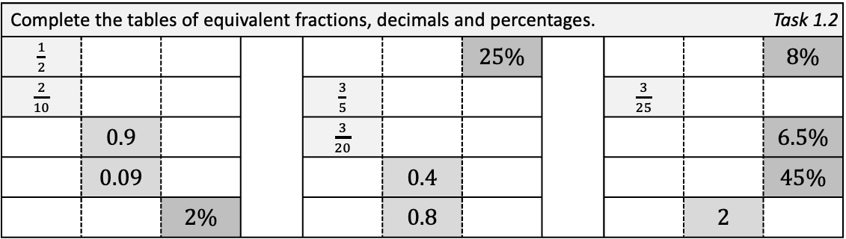
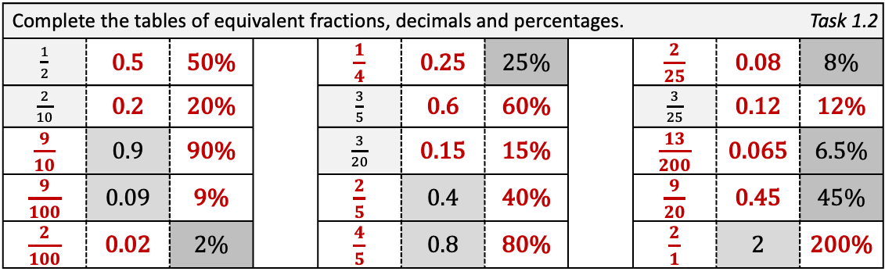
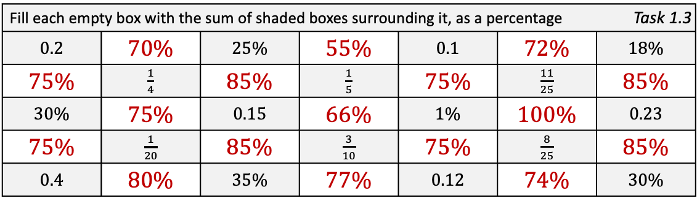
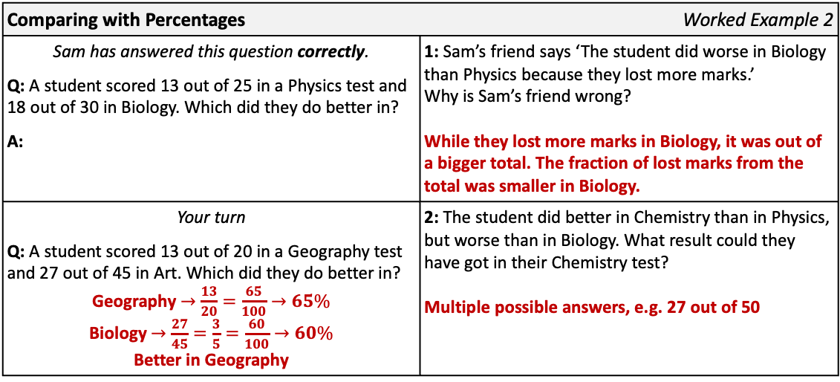
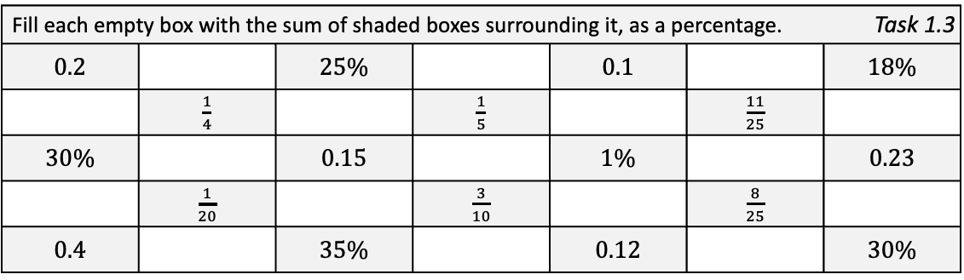

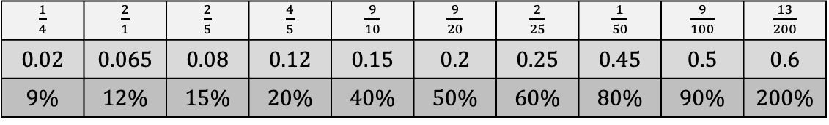
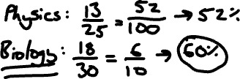
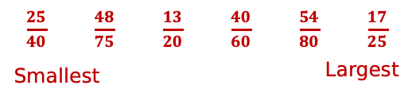
Complete the tables of equivalent fractions, decimals and percentages. |  |  |  |  |  |  |  | Task 1.2
$\frac{1}{2}$ |  |  |  |  |  | $25\%$ |  |  |  | $8\%$
$\frac{2}{10}$ |  |  |  | $\frac{3}{5}$ |  |  |  | $\frac{3}{25}$
 | $0.9$ |  |  | $\frac{3}{20}$ |  |  |  |  |  | $6.5\%$
 | $0.09$ |  |  |  | $0.4$ |  |  |  |  | $45\%$
 |  | $2\%$ |  |  | $0.8$ |  |  |  | $2$
Complete the tables of equivalent fractions, decimals and percentages. |  |  |  |  |  |  |  | Task 1.2
$\frac{1}{2}$ | 0.5 | 50% |  | $\frac{1}{4}$ | 0.25 | $25\%$ |  | $\frac{2}{25}$ | 0.08 | $8\%$
$\frac{2}{10}$ | 0.2 | 20% |  | $\frac{3}{5}$ | 0.6 | 60% |  | $\frac{3}{25}$ | 0.12 | 12%
$\frac{9}{10}$ | $0.9$ | 90% |  | $\frac{3}{20}$ | 0.15 | 15% |  | $\frac{13}{200}$ | 0.065 | $6.5\%$
$\frac{9}{100}$ | $0.09$ | 9% |  | $\frac{2}{5}$ | $0.4$ | 40% |  | $\frac{9}{20}$ | 0.45 | $45\%$
$\frac{2}{100}$ | 0.02 | $2\%$ |  | $\frac{4}{5}$ | $0.8$ | 80% |  | $\frac{2}{1}$ | $2$ | 200%
$\frac{1}{4}$ | $\frac{2}{1}$ | $\frac{2}{5}$ | $\frac{4}{5}$ | $\frac{9}{10}$ | $\frac{9}{20}$ | $\frac{2}{25}$ | $\frac{1}{50}$ | $\frac{9}{100}$ | $\frac{13}{200}$
0.02 | 0.065 | 0.08 | 0.12 | 0.15 | 0.2 | 0.25 | 0.45 | 0.5 | 0.6
9% | 12% | 15% | 20% | 40% | 50% | 60% | 80% | 90% | 200%
Fill each empty box with the sum of shaded boxes surrounding it, as a percentage. |  |  |  |  |  | Task 1.3
0.2 |  | 25% |  | 0.1 |  |  | 18%
 | $\frac{1}{4}$ |  | $\frac{1}{5}$ |  | $\frac{11}{25}$
30% |  | 0.15 |  | 1% |  |  | 0.23
 | $\frac{1}{20}$ |  | $\frac{3}{10}$ |  | $\frac{8}{25}$
0.4 |  | 35% |  | 0.12 |  |  | 30%
Fill each empty box with the sum of shaded boxes surrounding it, as a percentage |  |  |  |  |  | Task 1.3
0.2 | 70% | 25% | 55% | 0.1 | 72% |  | 18%
75% | $\frac{1}{4}$ | 85% | $\frac{1}{5}$ | 75% | $\frac{11}{25}$ |  | 85%
30% | 75% | 0.15 | 66% | 1% | 100% |  | 0.23
75% | $\frac{1}{20}$ | 85% | $\frac{3}{10}$ | 75% | $\frac{8}{25}$ |  | 85%
0.4 | 80% | 35% | 77% | 0.12 | 74% |  | 30%
Comparing with Percentages | Worked Example 2
Sam has answered this question correctly. Q: A student scored 13 out of 25 in a Physics test and 18 out of 30 in Biology. Which did they do better in? A: | 1: Sam’s friend says ‘The student did worse in Biology than Physics because they lost more marks.’ Why is Sam’s friend wrong?
Your turn Q: A student scored 13 out of 20 in a Geography test and 27 out of 45 in Art. Which did they do better in? A: | 2: The student did better in Chemistry than in Physics, but worse than in Biology. What result could they have got in their Chemistry test?
Comparing with Percentages | Worked Example 2
Sam has answered this question correctly. Q: A student scored 13 out of 25 in a Physics test and 18 out of 30 in Biology. Which did they do better in? A: | 1: Sam’s friend says ‘The student did worse in Biology than Physics because they lost more marks.’ Why is Sam’s friend wrong? While they lost more marks in Biology, it was out of a bigger total. The fraction of lost marks from the total was smaller in Biology.
Your turn Q: A student scored 13 out of 20 in a Geography test and 27 out of 45 in Art. Which did they do better in? Geography $→\frac{13}{20}=\frac{65}{100}→65\%$ Biology $→\frac{27}{45}=\frac{3}{5}=\frac{60}{100}→60\%$ Better in Geography | 2: The student did better in Chemistry than in Physics, but worse than in Biology. What result could they have got in their Chemistry test? Multiple possible answers, e.g. 27 out of 50
Order these test scores by converting to percentages. | Task 2.1
 | 1:
Order these test scores by converting to percentages | Task 2.1
 | 1:
$\frac{17}{25}$ | $\frac{25}{40}$ | $\frac{13}{20}$ | $\frac{48}{75}$ | $\frac{54}{80}$ | $\frac{40}{60}$
$\frac{17}{25}$ | $\frac{25}{40}$ | $\frac{13}{20}$ | $\frac{48}{75}$ | $\frac{54}{80}$ | $\frac{40}{60}$
$68\%$ | $62.5\%$ | $65\%$ | $64\%$ | $67.5\%$ | $66.\dot{6}\%$
$\frac{25}{40}$ | $\frac{48}{75}$ | $\frac{13}{20}$ | $\frac{40}{60}$ | $\frac{54}{80}$ | $\frac{17}{25}$
Smallest |  |  | Largest

Slide 3
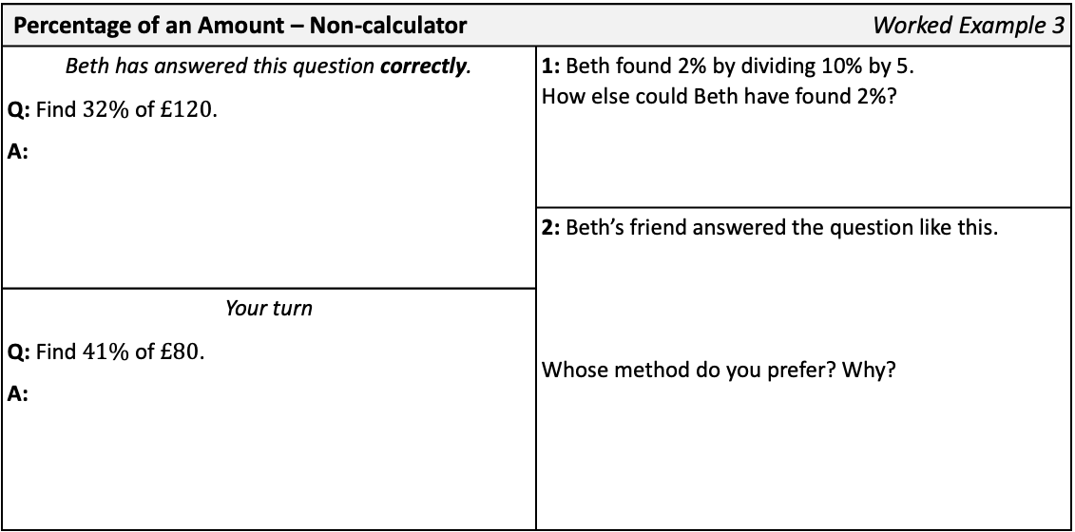
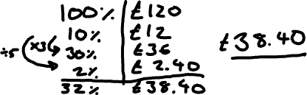
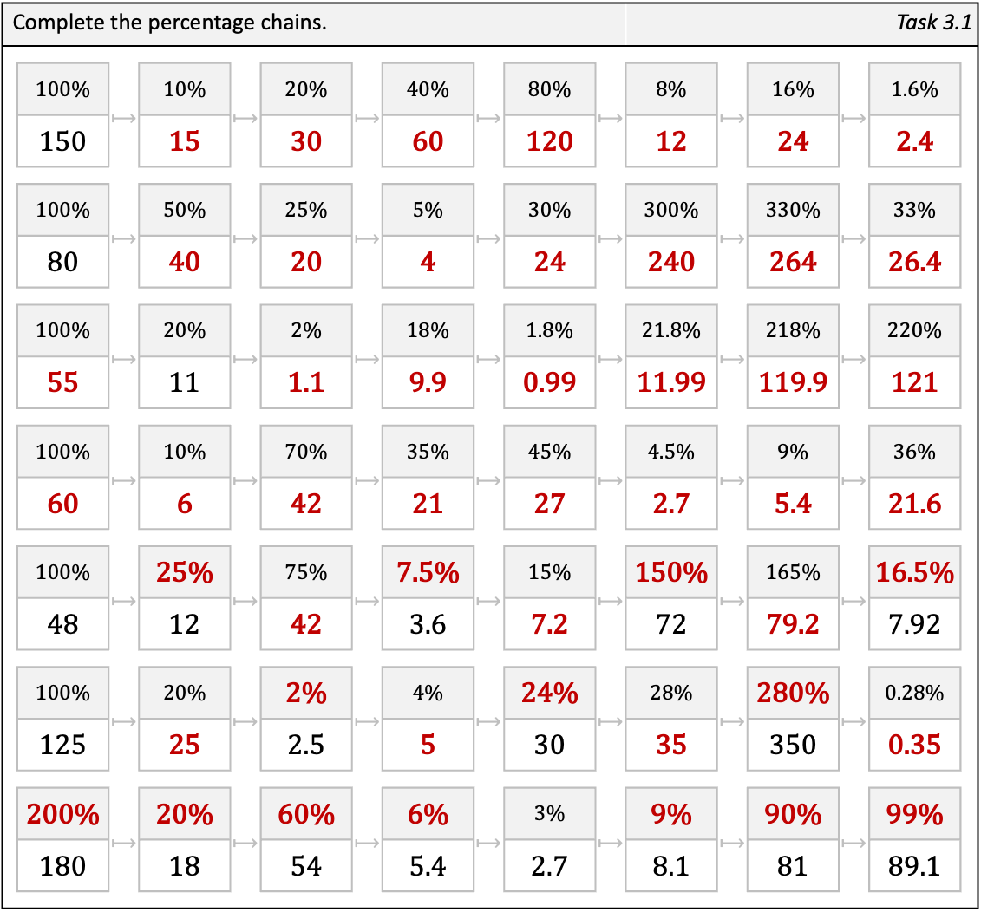
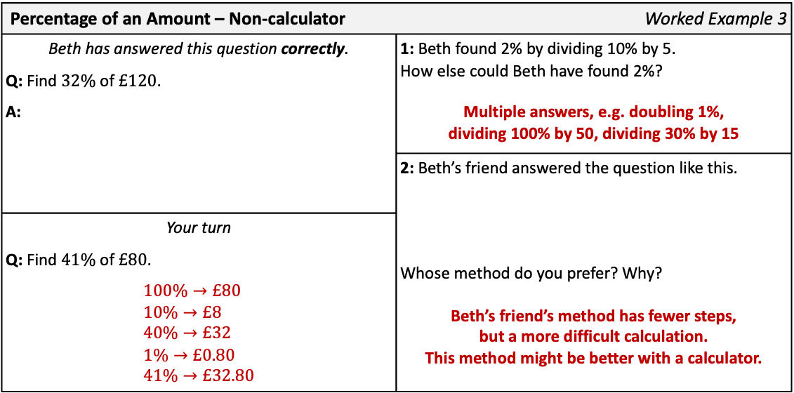
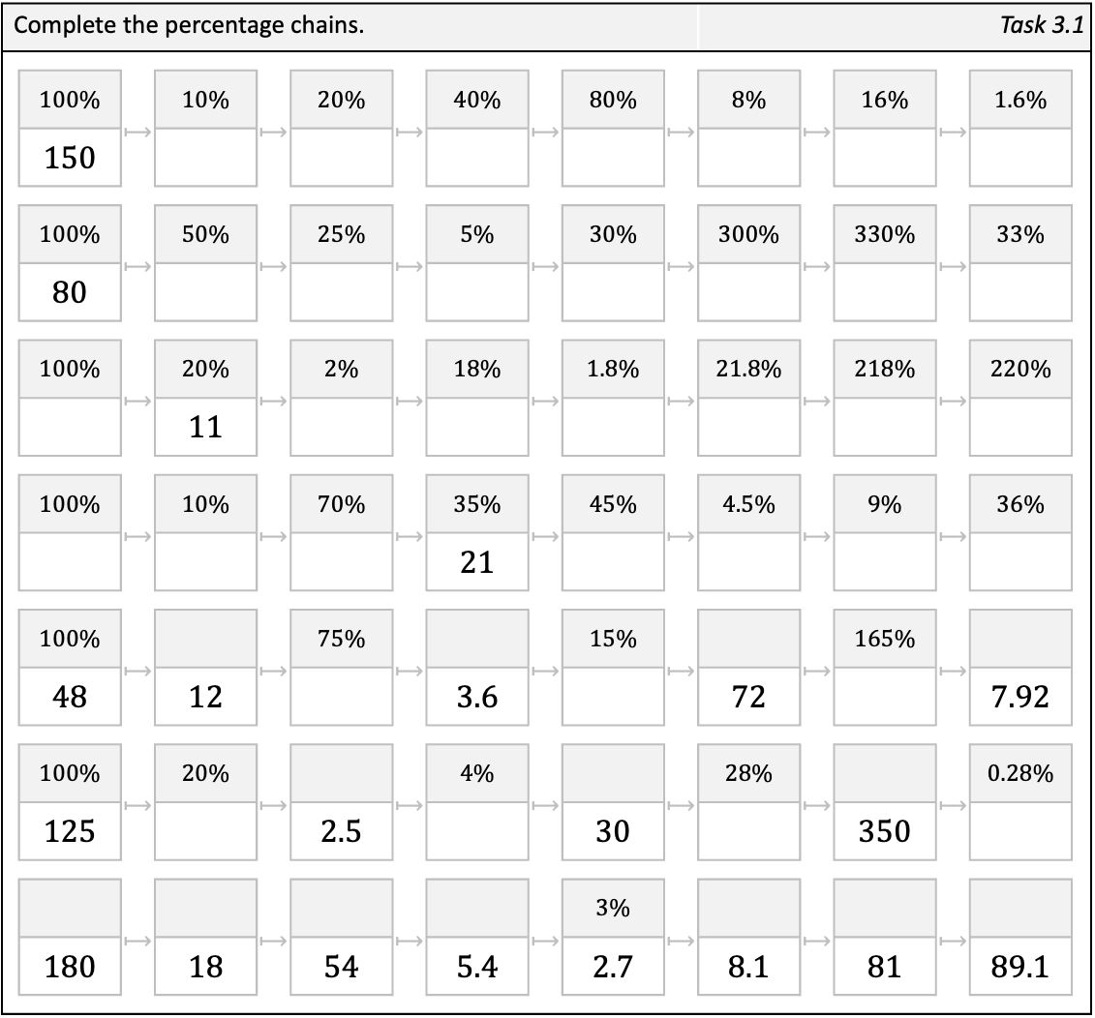
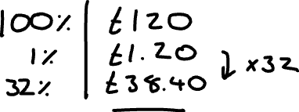
Percentage of an Amount – Non-calculator | Worked Example 3
Beth has answered this question correctly. Q: Find $32\%$ of $£120$. A: | 1: Beth found 2% by dividing 10% by 5. How else could Beth have found 2%?
 | 2: Beth’s friend answered the question like this. Whose method do you prefer? Why?
Your turn Q: Find $41\%$ of $£80$. A:
Percentage of an Amount – Non-calculator | Worked Example 3
Beth has answered this question correctly. Q: Find $32\%$ of $£120$. A: | 1: Beth found 2% by dividing 10% by 5. How else could Beth have found 2%? Multiple answers, e.g. doubling 1%, dividing 100% by 50, dividing 30% by 15
 | 2: Beth’s friend answered the question like this. Whose method do you prefer? Why? Beth’s friend’s method has fewer steps, but a more difficult calculation. This method might be better with a calculator.
Your turn Q: Find $41\%$ of $£80$. $$100\%→£80 \\ 10\%→£8 \\ 40\%→£32 \\ 1\%→£0.80 \\ 41\%→£32.80$$
Complete the percentage chains. | Complete the percentage chains |  |  |  |  |  |  |  |  |  | Task 3.1
 | 100% | $⟼$ | 10% | $⟼$ | 20% | $⟼$ | 40% | $⟼$ | 80% | $⟼$ | 8% | $⟼$ | 16% | $⟼$ | 1.6%
 | 150
 | 100% | $⟼$ | 50% | $⟼$ | 25% | $⟼$ | 5% | $⟼$ | 30% | $⟼$ | 300% | $⟼$ | 330% | $⟼$ | 33%
 | 80
 | 100% | $⟼$ | 20% | $⟼$ | 2% | $⟼$ | 18% | $⟼$ | 1.8% | $⟼$ | 21.8% | $⟼$ | 218% | $⟼$ | 220%
 |  |  | 11
 | 100% | $⟼$ | 10% | $⟼$ | 70% | $⟼$ | 35% | $⟼$ | 45% | $⟼$ | 4.5% | $⟼$ | 9% | $⟼$ | 36%
 |  |  |  |  |  |  | 21
 | 100% | $⟼$ |  | $⟼$ | 75% | $⟼$ |  | $⟼$ | 15% | $⟼$ |  | $⟼$ | 165% | $⟼$
 | 48 |  | 12 |  |  |  | 3.6 |  |  |  | 72 |  |  |  | 7.92
 | 100% | $⟼$ | 20% | $⟼$ |  | $⟼$ | 4% | $⟼$ |  | $⟼$ | 28% | $⟼$ |  | $⟼$ | 0.28%
 | 125 |  |  |  | 2.5 |  |  |  | 30 |  |  |  | 350
 |  | $⟼$ |  | $⟼$ |  | $⟼$ |  | $⟼$ | 3% | $⟼$ |  | $⟼$ |  | $⟼$
 | 180 |  | 18 |  | 54 |  | 5.4 |  | 2.7 |  | 8.1 |  | 81 |  | 89.1
Complete the percentage chains. | Complete the percentage chains |  |  |  |  |  |  |  |  |  | Task 3.1
 | 100% | $⟼$ | 10% | $⟼$ | 20% | $⟼$ | 40% | $⟼$ | 80% | $⟼$ | 8% | $⟼$ | 16% | $⟼$ | 1.6%
 | 150 |  | 15 |  | 30 |  | 60 |  | 120 |  | 12 |  | 24 |  | 2.4
 | 100% | $⟼$ | 50% | $⟼$ | 25% | $⟼$ | 5% | $⟼$ | 30% | $⟼$ | 300% | $⟼$ | 330% | $⟼$ | 33%
 | 80 |  | 40 |  | 20 |  | 4 |  | 24 |  | 240 |  | 264 |  | 26.4
 | 100% | $⟼$ | 20% | $⟼$ | 2% | $⟼$ | 18% | $⟼$ | 1.8% | $⟼$ | 21.8% | $⟼$ | 218% | $⟼$ | 220%
 | 55 |  | 11 |  | 1.1 |  | 9.9 |  | 0.99 |  | 11.99 |  | 119.9 |  | 121
 | 100% | $⟼$ | 10% | $⟼$ | 70% | $⟼$ | 35% | $⟼$ | 45% | $⟼$ | 4.5% | $⟼$ | 9% | $⟼$ | 36%
 | 60 |  | 6 |  | 42 |  | 21 |  | 27 |  | 2.7 |  | 5.4 |  | 21.6
 | 100% | $⟼$ | 25% | $⟼$ | 75% | $⟼$ | 7.5% | $⟼$ | 15% | $⟼$ | 150% | $⟼$ | 165% | $⟼$ | 16.5%
 | 48 |  | 12 |  | 42 |  | 3.6 |  | 7.2 |  | 72 |  | 79.2 |  | 7.92
 | 100% | $⟼$ | 20% | $⟼$ | 2% | $⟼$ | 4% | $⟼$ | 24% | $⟼$ | 28% | $⟼$ | 280% | $⟼$ | 0.28%
 | 125 |  | 25 |  | 2.5 |  | 5 |  | 30 |  | 35 |  | 350 |  | 0.35
 | 200% | $⟼$ | 20% | $⟼$ | 60% | $⟼$ | 6% | $⟼$ | 3% | $⟼$ | 9% | $⟼$ | 90% | $⟼$ | 99%
 | 180 |  | 18 |  | 54 |  | 5.4 |  | 2.7 |  | 8.1 |  | 81 |  | 89.1

Slide 4
Fill in the gaps. Cross off the shaded answers as you find them. |  |  |  |  |  |  | Task 3.2
100% | 10% | 1% | 5% | 15% | 30% | 16% | 130% | 84%
90 |  |  |  |  |  | 14.4
25
 | 8
 |  | 6
 |  |  | 12
 |  |  |  | 6
 |  |  |  |  | 9
Fill in the gaps. |  |  |  |  |  |  | Task 3.2
100% | 10% | 1% | 5% | 15% | 30% | 16% | 130% | 84%
90 | 9 | 0.9 | 4.5 | 13.5 | 27 | 14.4 | 117 | 75.6
25 | 2.5 | 0.25 | 1.25 | 3.75 | 7.5 | 4 | 32.5 | 21
80 | 8 | 0.8 | 4 | 12 | 24 | 12.8 | 104 | 67.2
600 | 60 | 6 | 30 | 90 | 180 | 96 | 780 | 504
240 | 24 | 2.4 | 12 | 36 | 72 | 38.4 | 312 | 201.6
40 | 4 | 0.4 | 2 | 6 | 12 | 6.4 | 52 | 33.6
30 | 3 | 0.3 | 1.5 | 4.5 | 9 | 4.8 | 39 | 25.2
500 | 50 | 5 | 2 | 75 | 150 | 80 | 650 | 420
4 | 4.8 | 6.4 | 12.8 | 14.4 | 21 | 25.2 | 32.5
33.6 | 38.4 | 39 | 52 | 67.2 | 75.6 | 80 | 96
104 | 117 | 201.6 | 312 | 420 | 504 | 650 | 780
Fill in the gaps. |  |  |  |  |  |  |  |  |  |  |  |  | Task 3.3 |  | Task
a | 25% | £17 | b | 50% | £350 | c | 5% | £15 | d | 25% |  | e | 25%
 | 50% |  |  | 10% |  |  | 20% |  |  | 75% | £900 |  | 10% | £60
f | 5% | £45 | g | 20% | £12 | h | 15% | £90 | i |  | £150 | j | 10%
 |  | £900 |  | 50% |  |  |  | £60 |  | 10% | £60 |  | 25% | £45
k | 48% | £480 | l | 48% | £480 | m | 48% | £80 | n | 80% | £48 | o | 15% | £48
 | 66% |  |  |  | £540 |  | 15% |  |  |  | £15 |  |  | £80
p | 100% | £210 | q | 100% |  | r | 100% | £210 | s | 100% |  | t | 100% | £60
 | 140% |  |  | 140% | £210 |  | 60% |  |  | 60% | £210 |  | 210%
u | 100% | £5 | v | 100% | £10 | w | 100% | £15 | x | 100% | £20 | y | 100 | £25
 |  | £3 |  |  | £3 |  |  | £3 |  |  | £3 |  |  | £3
Fill in the gaps. |  |  |  |  |  |  |  |  |  |  |  |  | Task 3.3 |  | Task
a | 25% | £17 | b | 50% | £350 | c | 5% | £15 | d | 25% | £300 | e | 25% | £150
 | 50% | £34 |  | 10% | £70 |  | 20% | £60 |  | 75% | £900 |  | 10% | £60
f | 5% | £45 | g | 20% | £12 | h | 15% | £90 | i | 15% | £150 | j | 10% | £18
 | 100% | £900 |  | 50% | £30 |  | 10% | £60 |  | 10% | £60 |  | 25% | £45
k | 48% | £480 | l | 48% | £480 | m | 48% | £80 | n | 80% | £48 | o | 15% | £48
 | 66% | £660 |  | 54% | £540 |  | 15% | £25 |  | 25% | £15 |  | 25% | £80
p | 100% | £210 | q | 100% | £150 | r | 100% | £210 | s | 100% | £350 | t | 100% | £60
 | 140% | £294 |  | 140% | £210 |  | 60% | £126 |  | 60% | £210 |  | 210% | £126
u | 100% | £5 | v | 100% | £10 | w | 100% | £15 | x | 100% | £20 | y | 100 | £25
 | 60% | £3 |  | 30% | £3 |  | 20% | £3 |  | 15% | £3 |  | 12% | £3

Slide 5
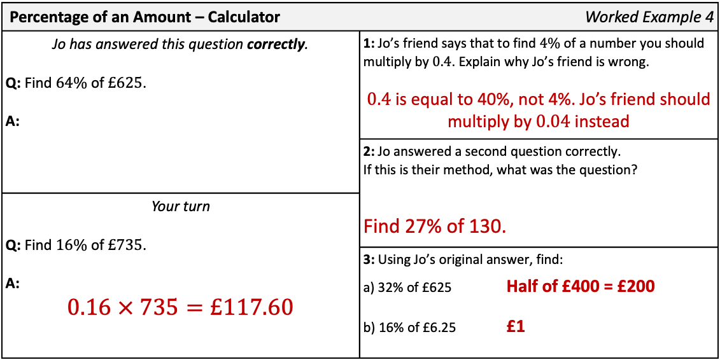
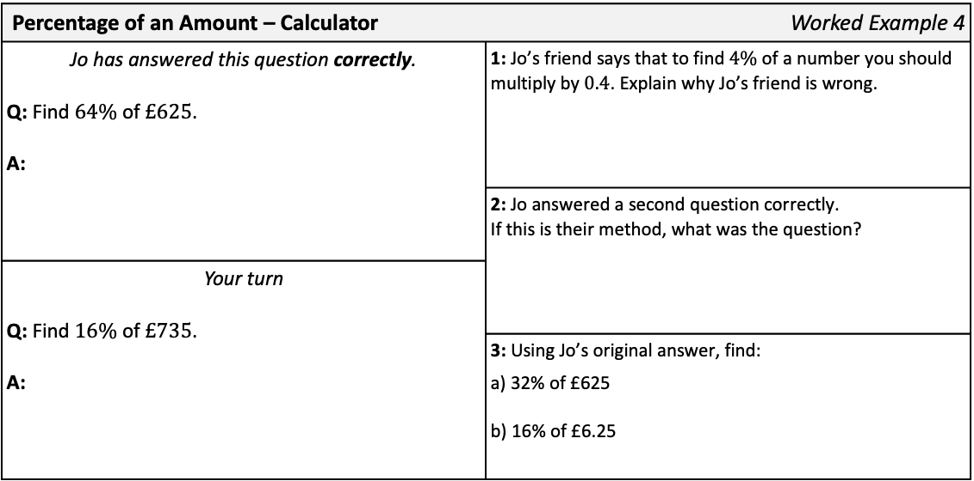

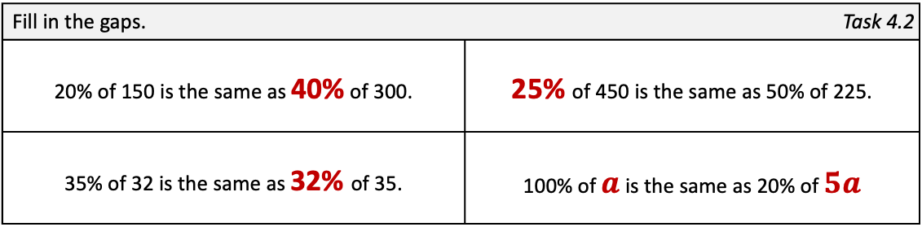

Percentage of an Amount – Calculator | Worked Example 4
Jo has answered this question correctly. Q: Find $64\%$ of $£625$. A: | 1: Jo’s friend says that to find $4\%$ of a number you should multiply by $0.4$. Explain why Jo’s friend is wrong.
 | 2: Jo answered a second question correctly. If this is their method, what was the question?
Your turn Q: Find $16\%$ of $£735$. A:
 | 3: Using Jo’s original answer, find: a) 32% of £625 b) 16% of £6.25
Percentage of an Amount – Calculator | Worked Example 4
Jo has answered this question correctly. Q: Find $64\%$ of $£625$. A: | 1: Jo’s friend says that to find $4\%$ of a number you should multiply by $0.4$. Explain why Jo’s friend is wrong. $0.4$ is equal to 40%, not 4%. Jo’s friend should multiply by $0.04$ instead
 | 2: Jo answered a second question correctly. If this is their method, what was the question? Find 27% of 130.
Your turn Q: Find $16\%$ of $£735$. A: $$0.16 × 735=£117.60$$
 | 3: Using Jo’s original answer, find: a) 32% of £625 Half of £400 = £200 b) 16% of £6.25 £1
Fill in the gaps. |  |  |  |  |  |  |  |  |  |  |  | Task 4.1
 | Question |  |  | Calculation |  |  | Answer |  | Question |  |  | Calculation |  |  | Answer
a | 36% | of | 175 | 0.36 | × | 175 |  | j |  | of |  | 0.07 | × | 300
b | 28% | of | 225 |  | × | 225 |  | k |  | of |  |  | × | 200 | 22
c | 30% | of | 210 |  | × |  |  | l | 46% | of |  |  | × |  | 23
d | 3% | of | 210 |  | × |  |  | m |  | of | 16 | 1.5 | ×
e | 35% | of |  |  | × | 40 |  | n | 62.5% | of |  |  | × | 40
f | 3.5% | of | 404 |  | × |  |  | o |  | of | 25 |  | × |  | 26
g | 350% | of | 122 |  | × |  |  | p | 33.75% | of | 80 |  | ×
h |  | of |  | 3.05 | × | 140 |  | q | 4.48% | of | 625 |  | ×
i | 140% | of | 305 |  | × |  |  | r | 362.5% | of |  |  | × |  | 29
Fill in the gaps. |  |  |  |  |  |  |  |  |  |  |  | Task 4.1
 | Question |  |  | Calculation |  |  | Answer |  | Question |  |  | Calculation |  |  | Answer
a | 36% | of | 175 | 0.36 | × | 175 | 63 | j | 7% | of | 300 | 0.07 | × | 300 | 21
b | 28% | of | 225 | 0.28 | × | 225 | 63 | k | 11% | of | 200 | 0.11 | × | 200 | 22
c | 30% | of | 210 | 0.3 | × | 210 | 63 | l | 46% | of | 50 | 0.46 | × | 50 | 23
d | 3% | of | 210 | 0.03 | × | 210 | 6.3 | m | 150% | of | 16 | 1.5 | × | 16 | 24
e | 35% | of | 40 | 0.35 | × | 40 | 14 | n | 62.5% | of | 40 | 0.625 | × | 40 | 25
f | 3.5% | of | 404 | 0.035 | × | 404 | 14.14 | o | 104% | of | 25 | 1.04 | × | 25 | 26
g | 350% | of | 122 | 3.5 | × | 122 | 427 | p | 33.75% | of | 80 | 0.3375 | × | 80 | 27
h | 305% | of | 140 | 3.05 | × | 140 | 427 | q | 4.48% | of | 625 | 0.0448 | × | 625 | 28
i | 140% | of | 305 | 1.4 | × | 305 | 427 | r | 362.5% | of | 8 | 3.625 | × | 8 | 29
Fill in the gaps. | Task 4.2
20% of 150 is the same as _______% of 300. | 1: | ________% of 450 is the same as 50% of 225.
35% of 32 is the same as ________% of 35. |  | 100% of ______ is the same as 20% of _______
Fill in the gaps. | Task 4.2
20% of 150 is the same as 40% of 300. | 1: | 25% of 450 is the same as 50% of 225.
35% of 32 is the same as 32% of 35. |  | 100% of $a$ is the same as 20% of $5a$

Slide 6
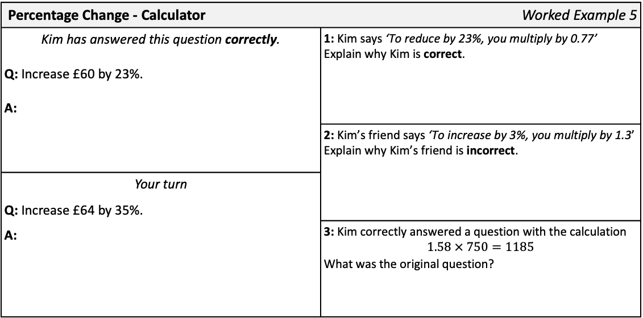
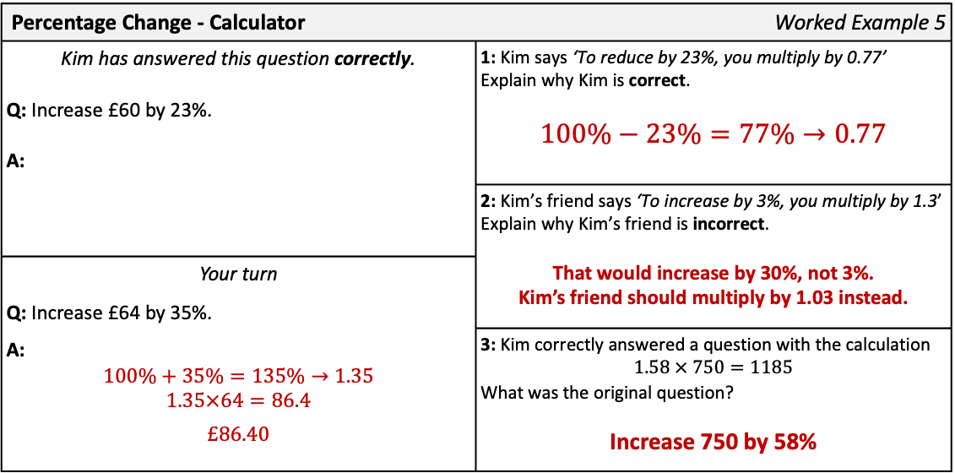

Percentage Change - Calculator | Worked Example 5
Kim has answered this question correctly. Q: Increase £60 by 23%. A: | 1: Kim says ‘To reduce by 23%, you multiply by 0.77’ Explain why Kim is correct.
 | 2: Kim’s friend says ‘To increase by 3%, you multiply by 1.3’ Explain why Kim’s friend is incorrect.
Your turn Q: Increase £64 by 35%. A:
 | 3: Kim correctly answered a question with the calculation $$1.58 × 750=1185$$ What was the original question?
Percentage Change - Calculator | Worked Example 5
Kim has answered this question correctly. Q: Increase £60 by 23%. A: | 1: Kim says ‘To reduce by 23%, you multiply by 0.77’ Explain why Kim is correct. $$100\%−23\%=77\%→0.77$$
 | 2: Kim’s friend says ‘To increase by 3%, you multiply by 1.3’ Explain why Kim’s friend is incorrect. That would increase by 30%, not 3%. Kim’s friend should multiply by 1.03 instead.
Your turn Q: Increase £64 by 35%. A: $$100\%+35\%=135\%→1.35$$ $$1.35×64=86.4$$ $$£86.40$$
 | 3: Kim correctly answered a question with the calculation $$1.58 × 750=1185$$ What was the original question? Increase 750 by 58%
Fill in the gaps |  |  |  |  |  | Task 5.1 |  |  |  |  |  | Task 3.1
 | Question |  |  |  | New % |  | Multiplier | Calculation |  |  | Answer
a | Increase | 15 | by | 54% | 154% |  | 1.54 | 1.54 | × | 15
b | Decrease | 30 | by | 23% | 77% |  | 0.77 |  | × | 30
c | Increase | 14 | by | 65% | 165% |  |  |  | ×
d | Decrease | 35 | by | 34% |  |  |  |  | ×
e | Increase | 22 | by |  | 105% |  |  |  | ×
f | Decrease |  | by |  |  |  | 0.7 |  | × | 33
g | Increase |  | by |  |  |  |  | 1.1 | × | 21
h |  |  | by |  |  |  |  | 0.55 | × | 42
i |  |  | by |  |  |  |  | 1.155 | × | 20
j | Decrease | 25 | by | 7.6% |  |  |  |  | ×
k | Decrease | 24 | by | 3.75% |  |  |  |  | ×
l | Increase | 12 | by | 92.5% |  |  |  |  | ×
m |  | 28 | by |  |  |  |  |  | × |  | 23.1
n | Decrease |  | by | 47.5% |  |  |  |  | × |  | 23.1
Fill in the gaps |  |  |  |  |  | Task 5.1 |  |  |  |  |  | Task 3.1
 | Question |  |  |  | New % |  | Multiplier | Calculation |  |  | Answer
a | Increase | 15 | by | 54% | 154% |  | 1.54 | 1.54 | × | 15 | 23.1
b | Decrease | 30 | by | 23% | 77% |  | 0.77 | 0.77 | × | 30 | 23.1
c | Increase | 14 | by | 65% | 165% |  | 1.65 | 1.65 | × | 14 | 23.1
d | Decrease | 35 | by | 34% | 66% |  | 0.66 | 0.66 | × | 35 | 23.1
e | Increase | 22 | by | 5% | 105% |  | 1.05 | 1.05 | × | 22 | 23.1
f | Decrease | 33 | by | 30% | 70% |  | 0.7 | 0.7 | × | 33 | 23.1
g | Increase | 21 | by | 10% | 110% |  | 1.1 | 1.1 | × | 21 | 23.1
h | Decrease | 42 | by | 45% | 55% |  | 0.55 | 0.55 | × | 42 | 23.1
i | Increase | 20 | by | 15.5% | 115.5% |  | 1.155 | 1.155 | × | 20 | 23.1
j | Decrease | 25 | by | 7.6% | 92.4% |  | 0.924 | 0.924 | × | 25 | 23.1
k | Decrease | 24 | by | 3.75% | 96.25% |  | 0.9625 | 0.9625 | × | 24 | 23.1
l | Increase | 12 | by | 92.5% | 192.5% |  | 1.925 | 1.925 | × | 12 | 23.1
m | Decrease | 28 | by | 17.5% | 82.5% |  | 0.825 | 0.825 | × | 28 | 23.1
n | Decrease | 44 | by | 47.5% | 52.5% |  | 0.525 | 0.525 | × | 44 | 23.1

Slide 7
Fill in the gaps |  |  |  |  |  | Task 5.2
% | Find | Increase by | Decrease by |  | % | Find | Increase by | Decrease by
42% | × 0.42 | × 1.42 | × 0.58 |  |  | × 0.15
37% |  |  |  |  |  |  | × 1.5
20% |  |  |  |  |  |  |  | × 0.15
8% |  |  |  |  |  | × 0.105
98% |  |  |  |  |  |  | × 1.05
108% |  |  |  |  |  |  |  | × 0.15
218% |  |  |  |  |  |  |  | × 0.995
21.8% |  |  |  |  |  |  | × 2.05
Bonus questions
50% of 24 |  |  | 20% of 55 |  |  | 80% of 50 |  |  | 90% of 60
25% of 120 |  |  | 20% of 110 |  |  | 80% of 250 |  |  | 90% of 15
75% of 120 |  |  | 20% of 165 |  |  | 25% of 56 |  |  | 70% of 70
10% of 90 |  |  | 40% of 5 |  |  | 35% of 40 |  |  | 70% of 7
10% of 9 |  |  | 40% of 55 |  |  | 75% of 48 |  |  | 70% of 35
10% of 19 |  |  | 40% of 155 |  |  | 75% of 240 |  |  | 20% of 45
50% of 24 | 12 |  | 20% of 55 | 11 |  | 80% of 50 | 40 |  | 90% of 60 | 54
25% of 120 | 30 |  | 20% of 110 | 22 |  | 80% of 250 | 200 |  | 90% of 15 | 13.5
75% of 120 | 90 |  | 20% of 165 | 33 |  | 25% of 56 | 14 |  | 70% of 70 | 49
10% of 90 | 9 |  | 40% of 5 | 2 |  | 35% of 40 | 14 |  | 70% of 7 | 4.9
10% of 9 | 0.9 |  | 40% of 55 | 22 |  | 75% of 48 | 32 |  | 70% of 35 | 24.5
10% of 19 | 9.9 |  | 40% of 155 | 62 |  | 75% of 240 | 180 |  | 20% of 45 | 9

