Slide 1
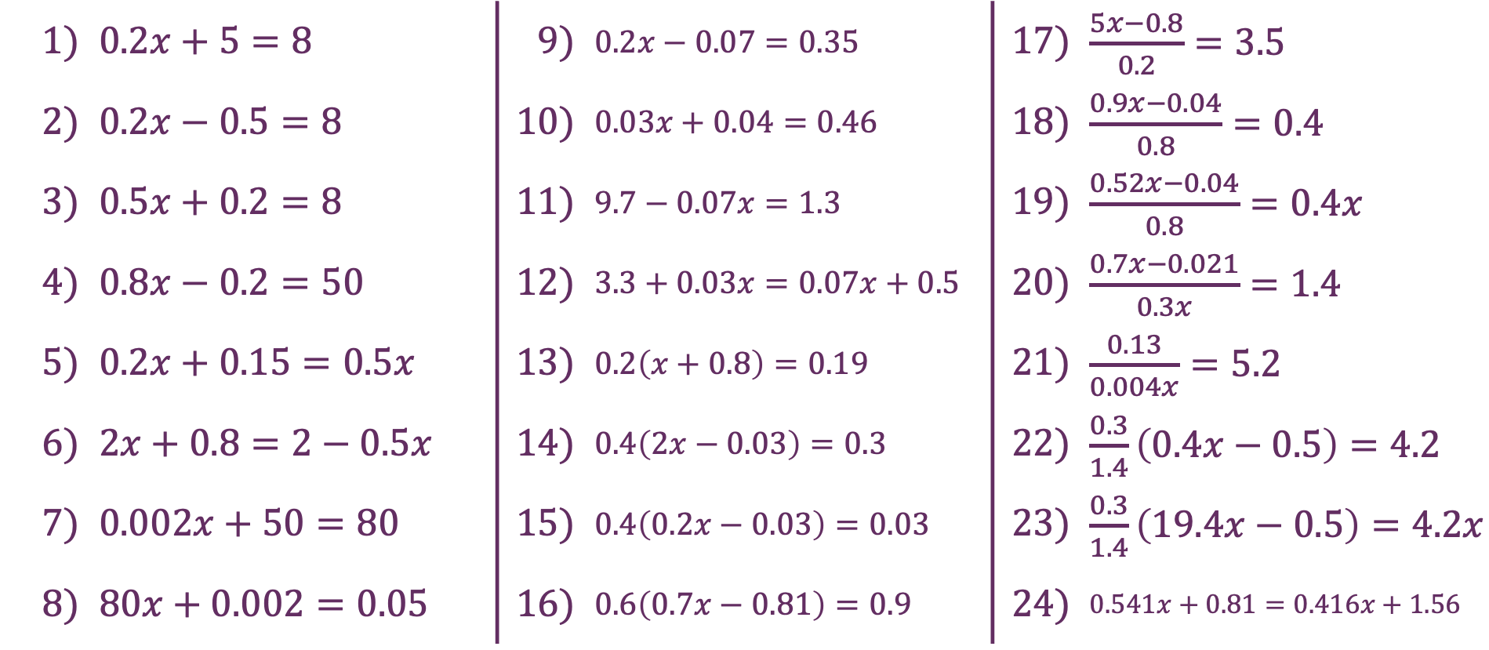
Decimals
1) | $0.2x+5=8$ | 9) | $0.2x−0.07=0.35$ | 17) | $\frac{5x−0.8}{0.2}=3.5$
2) | $0.2x−0.5=8$ | 10) | $0.03x+0.04=0.46$ | 18) | $\frac{0.9x−0.04}{0.8}=0.4$
3) | $0.5x+0.2=8$ | 11) | $9.7−0.07x=1.3$ | 19) | $\frac{0.52x−0.04}{0.8}=0.4x$
4) | $0.8x−0.2=50$ | 12) | $3.3+0.03x=0.07x+0.5$ | 20) | $\frac{0.7x−0.021}{0.3x}=1.4$
5) | $0.2x+0.15=0.5x$ | 13) | $0.2\left(x+0.8\right)=0.19$ | 21) | $\frac{0.13}{0.004x}=5.2$
6) | $2x+0.8=2−0.5x$ | 14) | $0.4\left(2x−0.03\right)=0.3$ | 22) | $\frac{0.3}{1.4}\left(0.4x−0.5\right)=4.2$
7) | $0.002x+50=80$ | 15) | $0.4\left(0.2x−0.03\right)=0.03$ | 23) | $\frac{0.3}{1.4}\left(19.4x−0.5\right)=4.2x$
8) | $80x+0.002=0.05$ | 16) | $0.6\left(0.7x−0.81\right)=0.9$ | 24) | $0.541x+0.81=0.416x+1.56$

Slide 2
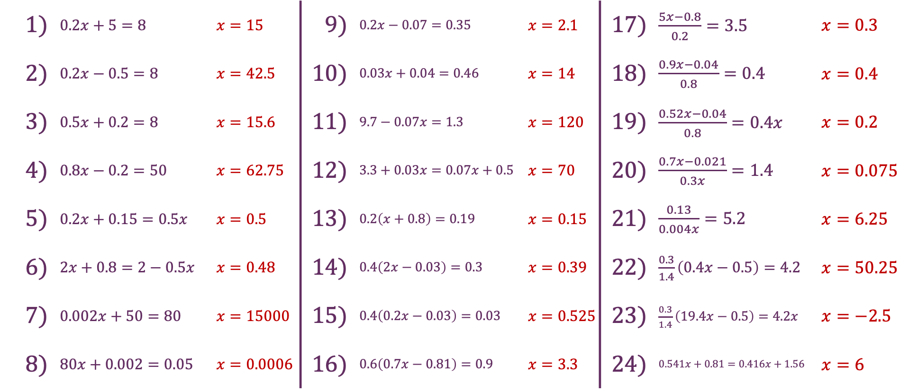
Decimals
1) | $0.2x+5=8$ | $x=15$ | 9) | $0.2x−0.07=0.35$ | $x=2.1$ | 17) | $\frac{5x−0.8}{0.2}=3.5$ | $x=0.3$
2) | $0.2x−0.5=8$ | $x=42.5$ | 10) | $0.03x+0.04=0.46$ | $x=14$ | 18) | $\frac{0.9x−0.04}{0.8}=0.4$ | $x=0.4$
3) | $0.5x+0.2=8$ | $x=15.6$ | 11) | $9.7−0.07x=1.3$ | $x=120$ | 19) | $\frac{0.52x−0.04}{0.8}=0.4x$ | $x=0.2$
4) | $0.8x−0.2=50$ | $x=62.75$ | 12) | $3.3+0.03x=0.07x+0.5$ | $x=70$ | 20) | $\frac{0.7x−0.021}{0.3x}=1.4$ | $x=0.075$
5) | $0.2x+0.15=0.5x$ | $x=0.5$ | 13) | $0.2\left(x+0.8\right)=0.19$ | $x=0.15$ | 21) | $\frac{0.13}{0.004x}=5.2$ | $x=6.25$
6) | $2x+0.8=2−0.5x$ | $x=0.48$ | 14) | $0.4\left(2x−0.03\right)=0.3$ | $x=0.39$ | 22) | $\frac{0.3}{1.4}\left(0.4x−0.5\right)=4.2$ | $x=50.25$
7) | $0.002x+50=80$ | $x=15000$ | 15) | $0.4\left(0.2x−0.03\right)=0.03$ | $x=0.525$ | 23) | $\frac{0.3}{1.4}\left(19.4x−0.5\right)=4.2x$ | $x=−2.5$
8) | $80x+0.002=0.05$ | $x=0.0006$ | 16) | $0.6\left(0.7x−0.81\right)=0.9$ | $x=3.3$ | 24) | $0.541x+0.81=0.416x+1.56$ | $x=6$

