Slide 1



Volume and Surface Area of a Cuboid
 | A | B | C | Volume | Surface Area
a. | 1 cm | 2 cm | 10 cm
b. | 1 cm | 2 cm |  | 10 cm³
c. | 1 cm | 2 cm |  |  | 10 cm²
d. | 2 cm | 5 cm | 90 cm
e. | 2 cm | 5 cm |  | 90 cm³
f. | 2 cm | 5 cm |  |  | 90 cm²
g. | 4 cm |  |  | 400 cm³ | 400 cm²
h. | 4 cm |  |  | 288 cm³ | 288 cm²
i. | 5 cm |  |  | 250 cm³ | 250 cm²
$C$
$B$
$A$

Slide 2
Volume and Surface Area of a Cuboid
Solutions
 | A | B | C | Volume | Surface Area
a. | 1 cm | 2 cm | 10 cm | 20 cm³ | 64 cm²
b. | 1 cm | 2 cm | 5 cm | 10 cm³ | 34 cm²
c. | 1 cm | 2 cm | 1 cm | 2 cm³ | 10 cm²
d. | 2 cm | 5 cm | 90 cm | 900 cm³ | 1280 cm²
e. | 2 cm | 5 cm | 9 cm | 90 cm³ | 146 cm²
f. | 2 cm | 5 cm | 5 cm | 50 cm³ | 90 cm²
g. | 4 cm | 5 cm | 20 cm | 400 cm³ | 400 cm²
h. | 4 cm | 6 cm | 12 cm | 288 cm³ | 288 cm²
i. | 5 cm | 5 cm | 10 cm | 250 cm³ | 250 cm²
$C$
$B$
$A$

Slide 3


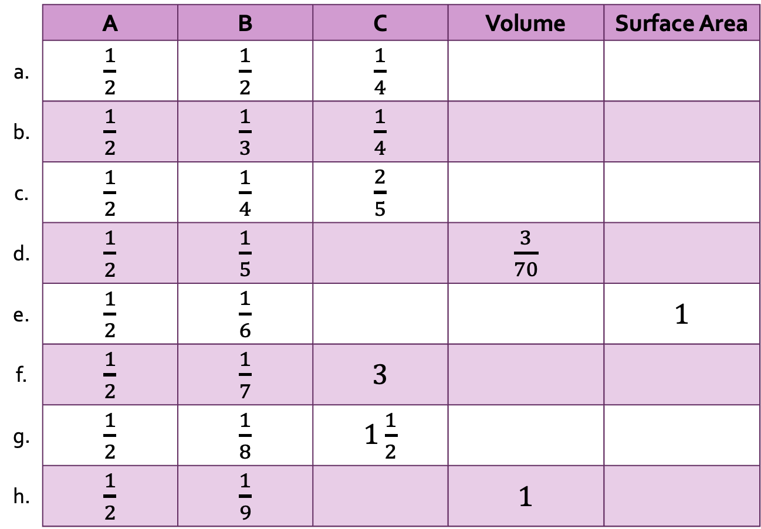

Fractions
Volume and Surface Area of a Cuboid with…
 | A | B | C | Volume | Surface Area
a. | $\frac{1}{2}$ | $\frac{1}{2}$ | $\frac{1}{4}$
b. | $\frac{1}{2}$ | $\frac{1}{3}$ | $\frac{1}{4}$
c. | $\frac{1}{2}$ | $\frac{1}{4}$ | $\frac{2}{5}$
d. | $\frac{1}{2}$ | $\frac{1}{5}$ |  | $\frac{3}{70}$
e. | $\frac{1}{2}$ | $\frac{1}{6}$ |  |  | $1$
f. | $\frac{1}{2}$ | $\frac{1}{7}$ | $3$
g. | $\frac{1}{2}$ | $\frac{1}{8}$ | $1\frac{1}{2}$
h. | $\frac{1}{2}$ | $\frac{1}{9}$ |  | $1$
$C$
$B$
$A$

Slide 4
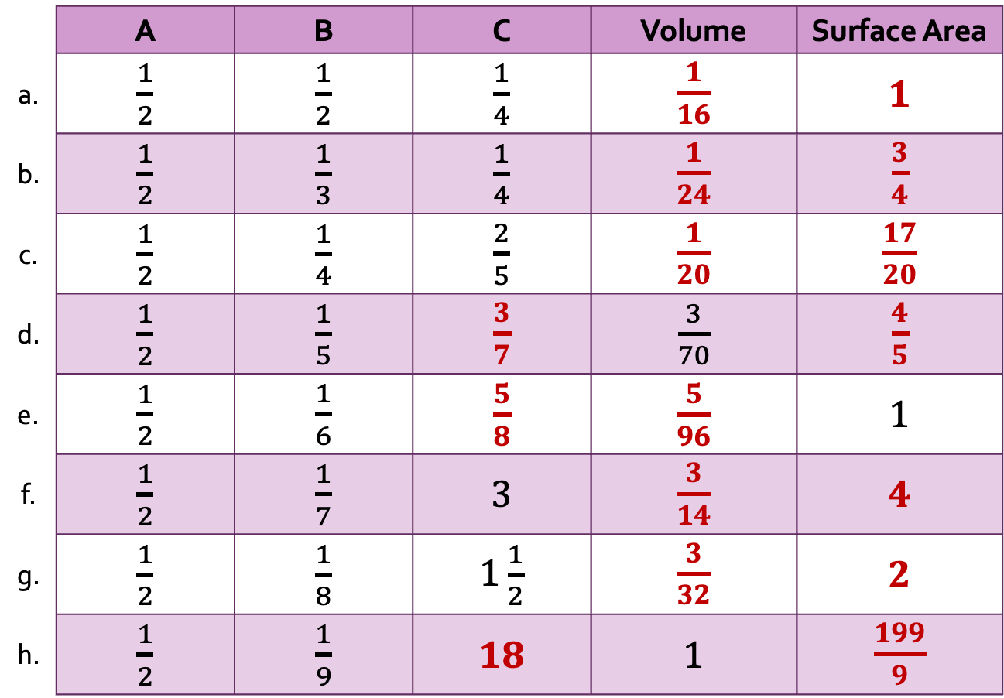
Fractions
Volume and Surface Area of a Cuboid with…
Solutions
 | A | B | C | Volume | Surface Area
a. | $\frac{1}{2}$ | $\frac{1}{2}$ | $\frac{1}{4}$ | $\frac{1}{16}$ | $1$
b. | $\frac{1}{2}$ | $\frac{1}{3}$ | $\frac{1}{4}$ | $\frac{1}{24}$ | $\frac{3}{4}$
c. | $\frac{1}{2}$ | $\frac{1}{4}$ | $\frac{2}{5}$ | $\frac{1}{20}$ | $\frac{17}{20}$
d. | $\frac{1}{2}$ | $\frac{1}{5}$ | $\frac{3}{7}$ | $\frac{3}{70}$ | $\frac{4}{5}$
e. | $\frac{1}{2}$ | $\frac{1}{6}$ | $\frac{5}{8}$ | $\frac{5}{96}$ | $1$
f. | $\frac{1}{2}$ | $\frac{1}{7}$ | $3$ | $\frac{3}{14}$ | $4$
g. | $\frac{1}{2}$ | $\frac{1}{8}$ | $1\frac{1}{2}$ | $\frac{3}{32}$ | $2$
h. | $\frac{1}{2}$ | $\frac{1}{9}$ | $18$ | $1$ | $\frac{199}{9}$
$C$
$B$
$A$

Slide 5
Decimals
Volume and Surface Area of a Cuboid with…
 | A | B | C | Volume | Surface Area
a. | 0.25 cm | 0.4 cm | 10 cm
b. | 0.25 cm | 0.6 cm | 1 cm
c. | 0.5 cm | 0.2 cm | 2 cm
d. | 1.6 cm | 0.5 cm |  | 4 cm³
e. | 1.5 cm | 1 cm |  |  | 5 cm²
f. | 0.75 cm | 0.8 cm |  | 6 cm³
g. | 1.4 cm | 2.5 cm |  | 7 cm³
h. | 0.5 cm | 2 cm |  |  | 8 cm²
i. | 1.2 cm | 1.5 cm |  |  | 9 cm²
$C$
$B$
$A$

Slide 6
Decimals
Volume and Surface Area of a Cuboid with…
Solutions
 | A | B | C | Volume | Surface Area
a. | 0.25 cm | 0.4 cm | 10 cm | 1 cm³ | 13.2 cm²
b. | 0.25 cm | 0.6 cm | 1 cm | 0.15 cm³ | 2 cm²
c. | 0.5 cm | 0.2 cm | 2 cm | 0.2 cm³ | 3 cm²
d. | 1.6 cm | 0.5 cm | 5 cm | 4 cm³ | 22.6 cm²
e. | 1.5 cm | 1 cm | 0.4 cm | 0.6 cm³ | 5 cm²
f. | 0.75 cm | 0.8 cm | 10 cm | 6 cm³ | 32.2 cm²
g. | 1.4 cm | 2.5 cm | 2 cm | 7 cm³ | 22.6 cm²
h. | 0.5 cm | 2 cm | 1.2 cm | 1.2 cm³ | 8 cm²
i. | 1.2 cm | 1.5 cm | 1 cm | 1.8 cm³ | 9 cm²
$C$
$B$
$A$

Slide 7
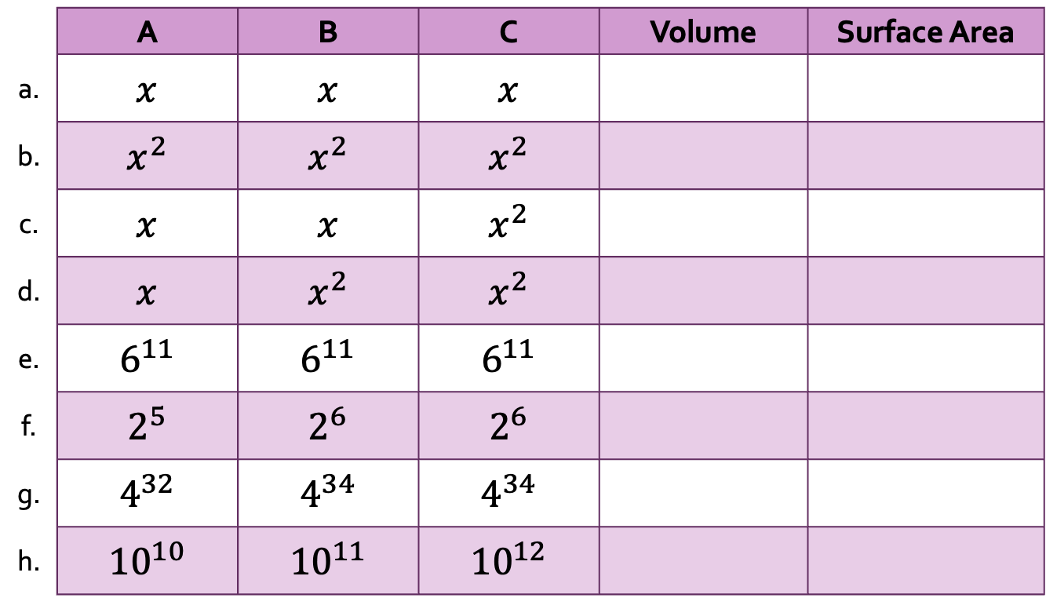
Volume and Surface Area of a Cuboid with…
Laws of Indices
 | A | B | C | Volume | Surface Area
a. | $x$ | $x$ | $x$
b. | $x^{2}$ | $x^{2}$ | $x^{2}$
c. | $x$ | $x$ | $x^{2}$
d. | $x$ | $x^{2}$ | $x^{2}$
e. | $6^{11}$ | $6^{11}$ | $6^{11}$
f. | $2^{5}$ | $2^{6}$ | $2^{6}$
g. | $4^{32}$ | $4^{34}$ | $4^{34}$
h. | ${10}^{10}$ | ${10}^{11}$ | ${10}^{12}$
$C$
$B$
$A$

Slide 8
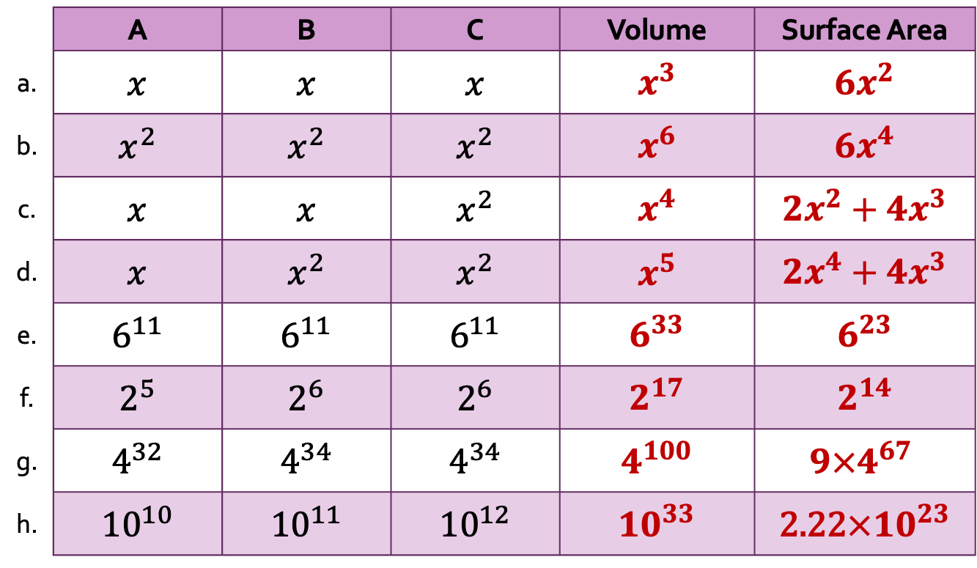
Laws of Indices
Volume and Surface Area of a Cuboid with…
Solutions
 | A | B | C | Volume | Surface Area
a. | $x$ | $x$ | $x$ | $x^{3}$ | $6x^{2}$
b. | $x^{2}$ | $x^{2}$ | $x^{2}$ | $x^{6}$ | ${6x}^{4}$
c. | $x$ | $x$ | $x^{2}$ | $x^{4}$ | $2x^{2}+4x^{3}$
d. | $x$ | $x^{2}$ | $x^{2}$ | $x^{5}$ | ${2x}^{4}+4x^{3}$
e. | $6^{11}$ | $6^{11}$ | $6^{11}$ | $6^{33}$ | $6^{23}$
f. | $2^{5}$ | $2^{6}$ | $2^{6}$ | $2^{17}$ | $2^{14}$
g. | $4^{32}$ | $4^{34}$ | $4^{34}$ | $4^{100}$ | $$9×4^{67}$$
h. | ${10}^{10}$ | ${10}^{11}$ | ${10}^{12}$ | ${10}^{33}$ | 2.22$×{10}^{23}$
$C$
$B$
$A$

Slide 9

Volume and Surface Area of a Cuboid with…
 | A | B | C | Volume | Surface Area
a. | $x$ | $2$ | $2$
b. | $x$ | $x$ | $2$
c. |  | $x$ | $2$ | $4x^{2}$
d. | $2x$ | $2x$ | $2$
e. | $2x$ |  | $2$ | $8x$
f. | $2+x$ | $2$ | $2$ | $8+4x$
g. |  |  |  | $8−4x$ | $24−8x$
h. | $2−x$ | $2+x$ | $2$
i. | $2−x$ | $2+x$ | $x^{2}$
Algebra
$C$
$B$
$A$

Slide 10

Volume and Surface Area of a Cuboid with…
Solutions
 | A | B | C | Volume | Surface Area
a. | $x$ | $2$ | $2$ | $4x$ | $8x+8$
b. | $x$ | $x$ | $2$ | $2x^{2}$ | $2x^{2}+4x$
c. | $2x$ | $x$ | $2$ | $4x^{2}$ | $4x^{2}+12x$
d. | $2x$ | $2x$ | $2$ | $8x^{2}$ | $8x^{2}+16x$
e. | $2x$ | $2$ | $2$ | $8x$ | $16x+8$
f. | $2+x$ | $2$ | $2$ | $8+4x$ | $24+8x$
g. | $2−x$ | $2$ | $2$ | $8−4x$ | $24−8x$
h. | $2−x$ | $2+x$ | $2$ | $8−2x^{2}$ | $24−{2x}^{2}$
i. | $2−x$ | $2+x$ | $x^{2}$ | $4x^{2}−x^{4}$ | $$8−x^{2}$$
Algebra
$C$
$B$
$A$

Slide 11
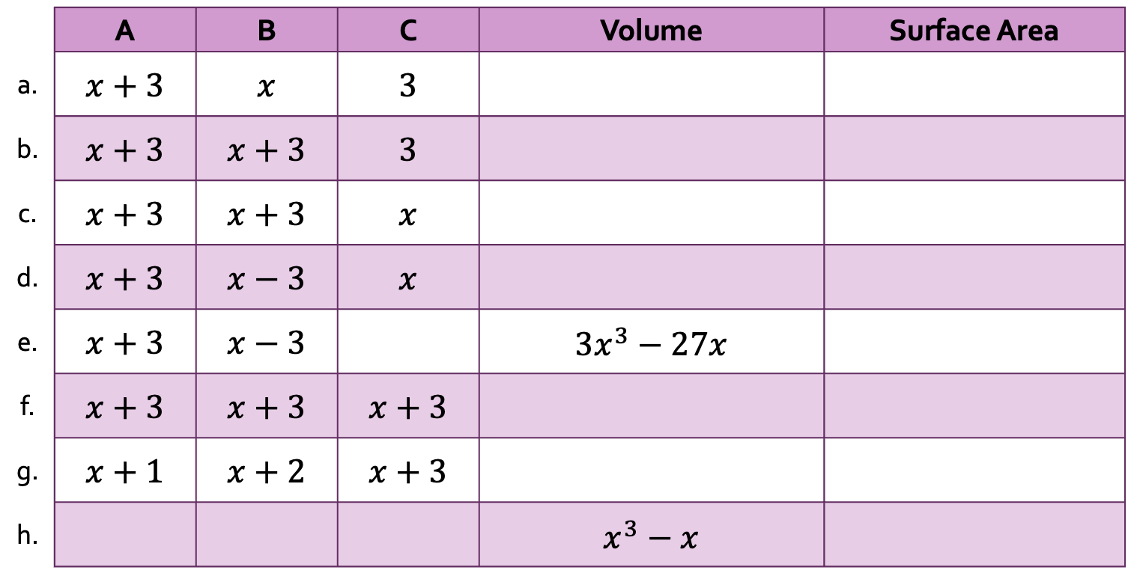
Volume and Surface Area of a Cuboid with…
Expanding Brackets
 | A | B | C | Volume | Surface Area
a. | $x+3$ | $x$ | $3$
b. | $x+3$ | $x+3$ | $3$
c. | $x+3$ | $x+3$ | $x$
d. | $x+3$ | $x−3$ | $x$
e. | $x+3$ | $x−3$ |  | $3x^{3}−27x$
f. | $x+3$ | $x+3$ | $x+3$
g. | $x+1$ | $x+2$ | $x+3$
h. |  |  |  | $x^{3}−x$
$C$
$B$
$A$

Slide 12
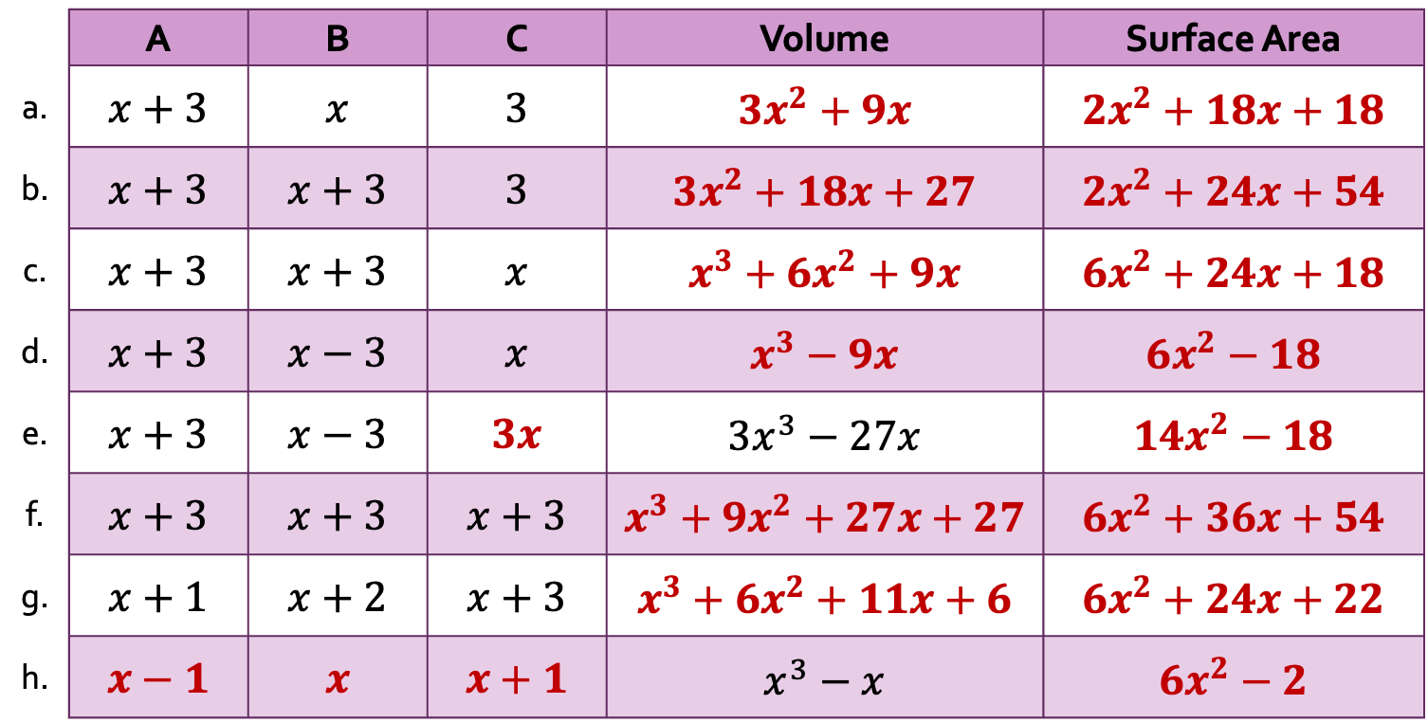
Expanding Brackets
Volume and Surface Area of a Cuboid with…
Solutions
 | A | B | C | Volume | Surface Area
a. | $x+3$ | $x$ | $3$ | $3x^{2}+9x$ | $2x^{2}+18x+18$
b. | $x+3$ | $x+3$ | $3$ | $3x^{2}+18x+27$ | $2x^{2}+24x+54$
c. | $x+3$ | $x+3$ | $x$ | $x^{3}+6x^{2}+9x$ | $6x^{2}+24x+18$
d. | $x+3$ | $x−3$ | $x$ | $x^{3}−9x$ | $6x^{2}−18$
e. | $x+3$ | $x−3$ | $3x$ | $3x^{3}−27x$ | $14x^{2}−18$
f. | $x+3$ | $x+3$ | $x+3$ | $x^{3}+9x^{2}+27x+27$ | $6x^{2}+36x+54$
g. | $x+1$ | $x+2$ | $x+3$ | $x^{3}+6x^{2}+11x+6$ | $6x^{2}+24x+22$
h. | $x−1$ | $x$ | $x+1$ | $x^{3}−x$ | $6x^{2}−2$
$C$
$B$
$A$

Slide 13

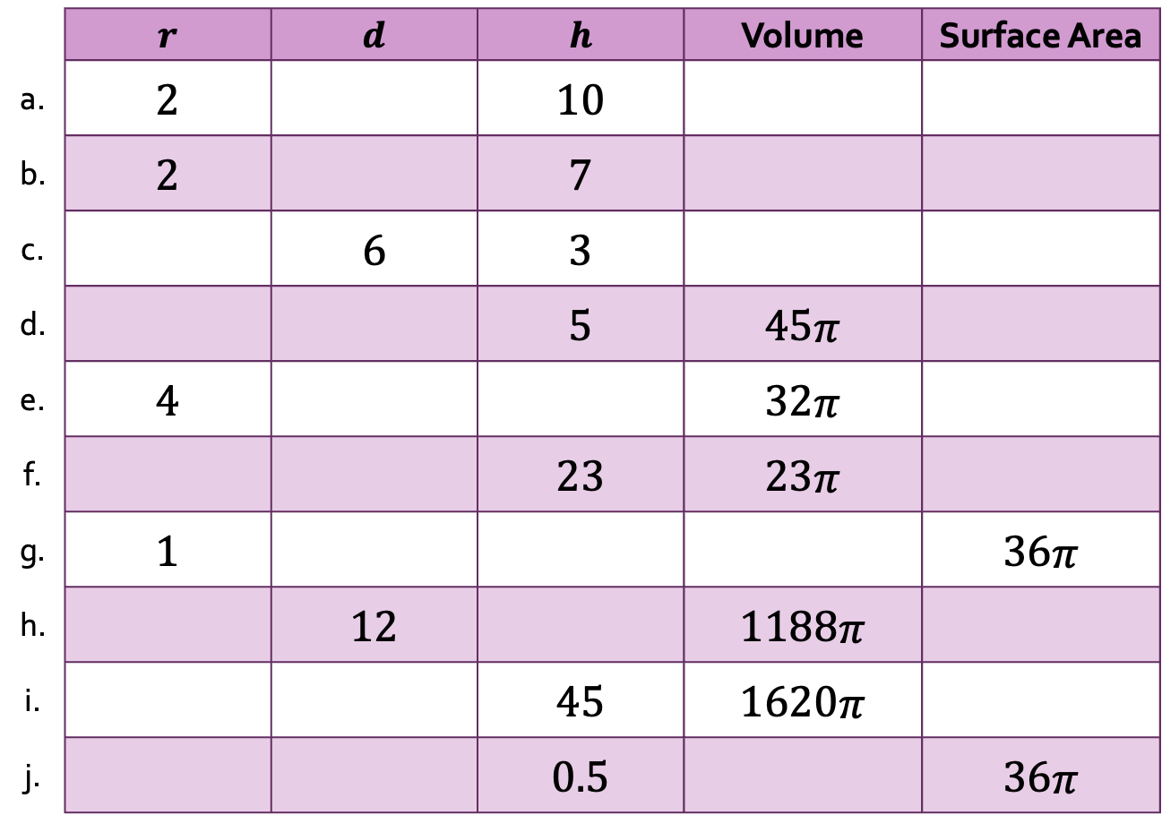


Volume and Surface Area of a Cylinder
 | $r$ | $d$ | $h$ | Volume | Surface Area
a. | 2 |  | 10
b. | 2 |  | 7
c. |  | 6 | 3
d. |  |  | 5 | 45$π$
e. | 4 |  |  | 32$π$
f. |  |  | 23 | 23$π$
g. | 1 |  |  |  | 36$π$
h. |  | 12 |  | 1188$π$
i. |  |  | 45 | 1620$π$
j. |  |  | 0.5 |  | 36$π$
$d$
$r$
$h$

Slide 14
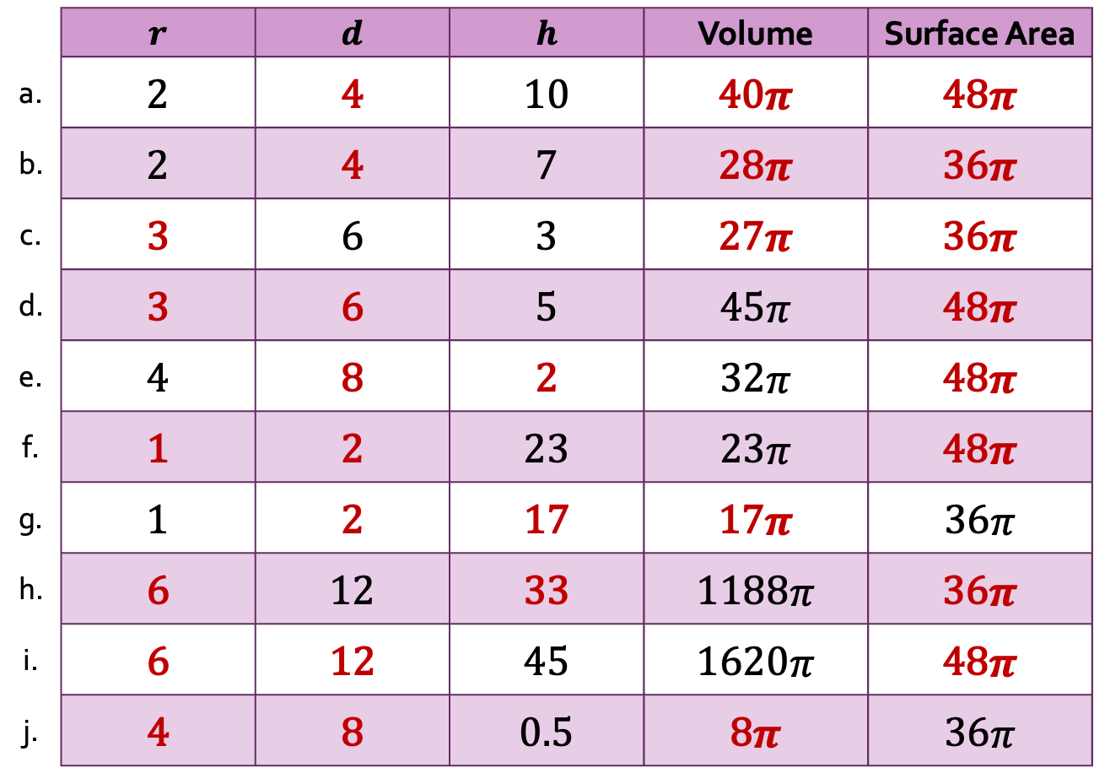
Volume and Surface Area of a Cylinder
Solutions
 | $r$ | $d$ | $h$ | Volume | Surface Area
a. | 2 | 4 | 10 | 40$π$ | 48$π$
b. | 2 | 4 | 7 | 28$π$ | 36$π$
c. | 3 | 6 | 3 | 27$π$ | 36$π$
d. | 3 | 6 | 5 | 45$π$ | 48$π$
e. | 4 | 8 | 2 | 32$π$ | 48$π$
f. | 1 | 2 | 23 | 23$π$ | 48$π$
g. | 1 | 2 | 17 | 17$π$ | 36$π$
h. | 6 | 12 | 33 | 1188$π$ | 36$π$
i. | 6 | 12 | 45 | 1620$π$ | 48$π$
j. | 4 | 8 | 0.5 | 8$π$ | 36$π$
$d$
$r$
$h$

Slide 15


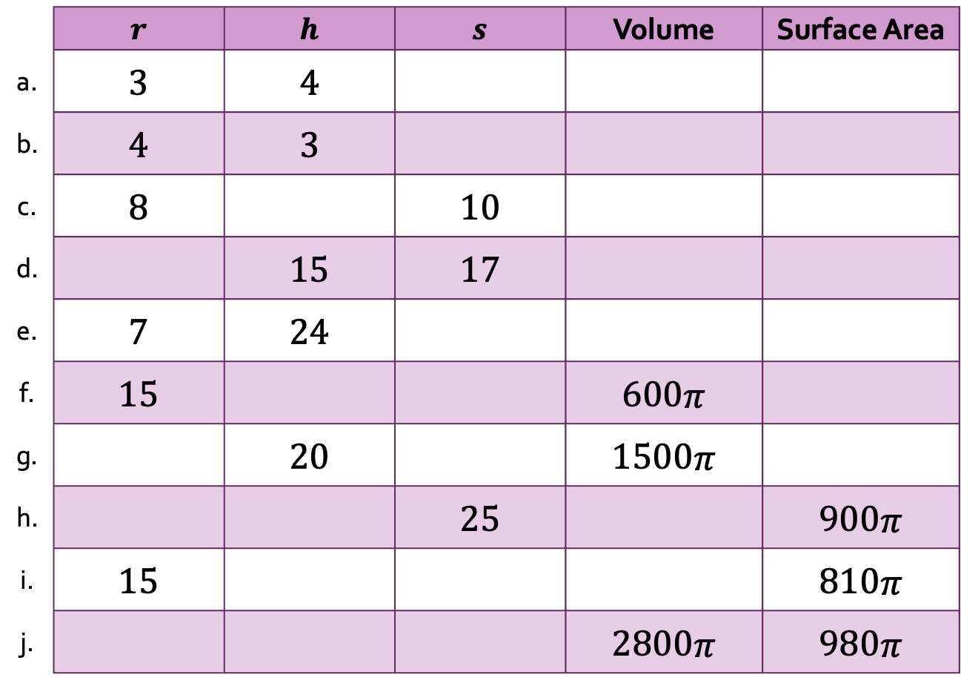

Volume and Surface Area of a Cone
 | $r$ | $h$ | $s$ | Volume | Surface Area
a. | 3 | 4
b. | 4 | 3
c. | 8 |  | 10
d. |  | 15 | 17
e. | 7 | 24
f. | 15 |  |  | 600$π$
g. |  | 20 |  | 1500$π$
h. |  |  | 25 |  | 900$π$
i. | 15 |  |  |  | 810$π$
j. |  |  |  | 2800$π$ | 980$π$
$h$
$s$
$r$

Slide 16
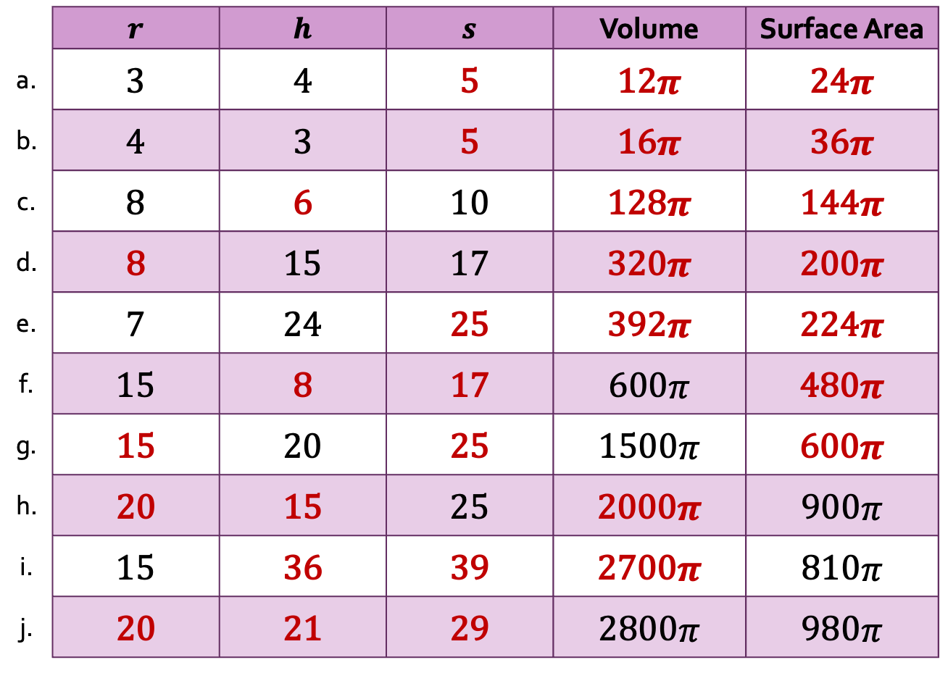
Volume and Surface Area of a Cone
Solutions
 | $r$ | $h$ | $s$ | Volume | Surface Area
a. | 3 | 4 | 5 | 12$π$ | 24$π$
b. | 4 | 3 | 5 | 16$π$ | 36$π$
c. | 8 | 6 | 10 | 128$π$ | 144$π$
d. | 8 | 15 | 17 | 320$π$ | 200$π$
e. | 7 | 24 | 25 | 392$π$ | 224$π$
f. | 15 | 8 | 17 | 600$π$ | 480$π$
g. | 15 | 20 | 25 | 1500$π$ | 600$π$
h. | 20 | 15 | 25 | 2000$π$ | 900$π$
i. | 15 | 36 | 39 | 2700$π$ | 810$π$
j. | 20 | 21 | 29 | 2800$π$ | 980$π$
$h$
$s$
$r$

